Slide 1
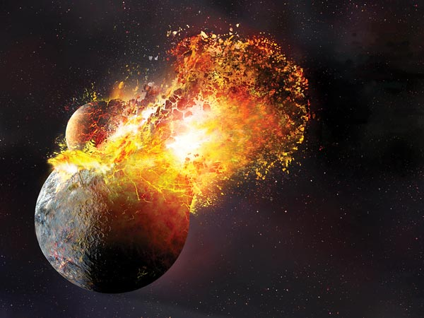
The Azeotropic Boiling Curve for Silica and the Giant Impact Hypothesis for Lunar Origin
Immanuel Velikovsky Junior
The Giant Impact model for lunar origin
Experimental and theoretical models for silica at extreme conditions
A new, partially successful, model for silica
An implication?

Slide 2
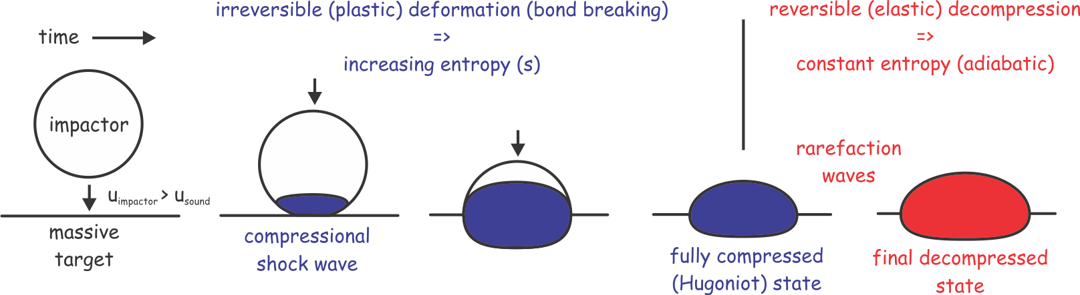
A dilletante’s summary of impact physics

Slide 3
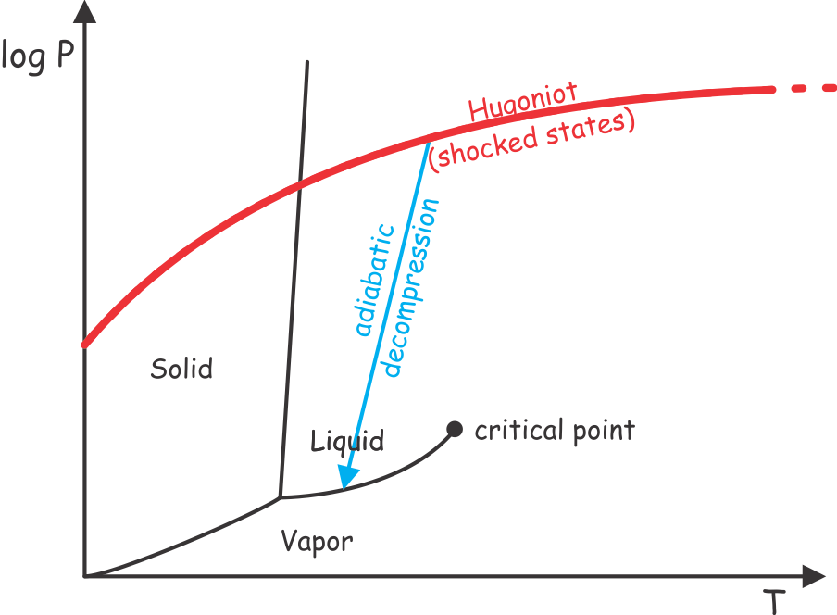
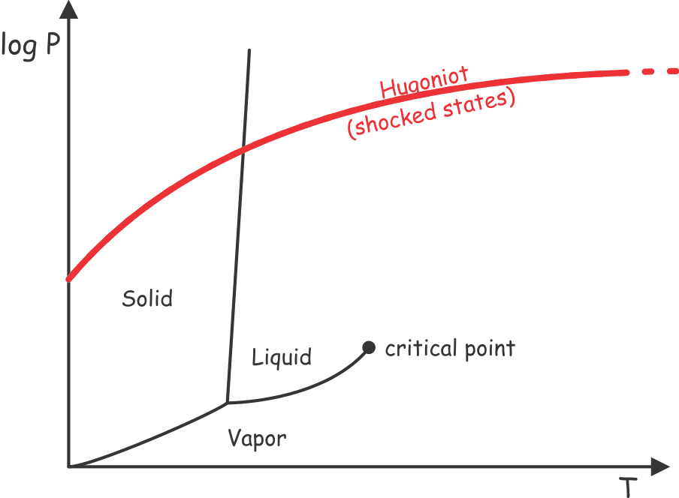
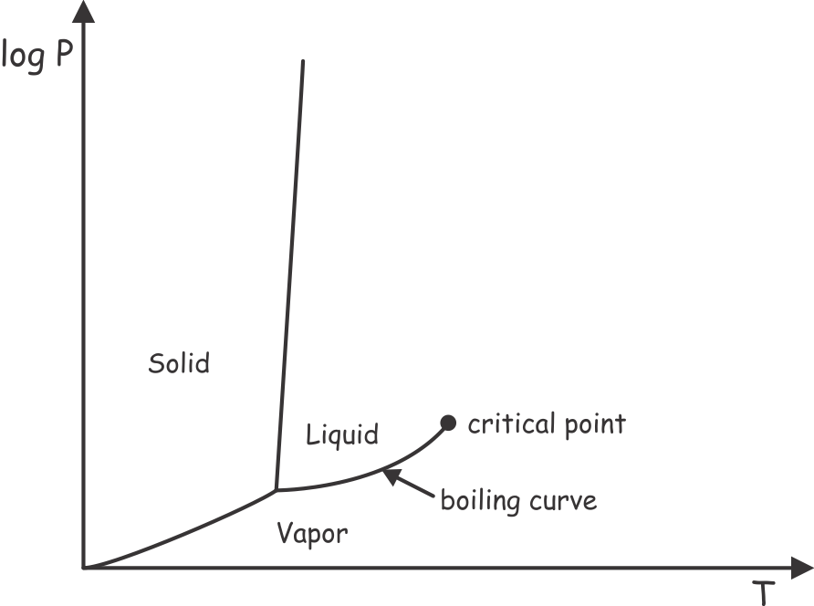
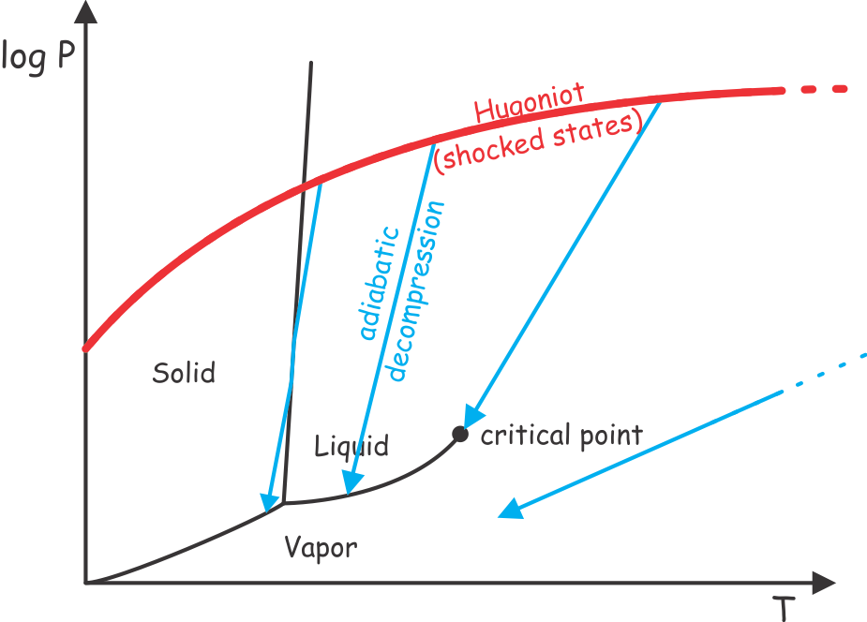
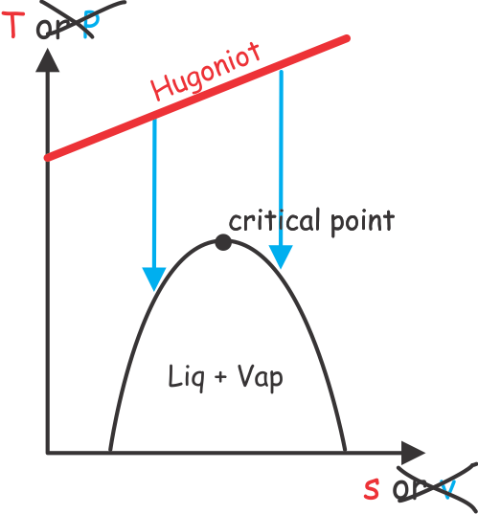
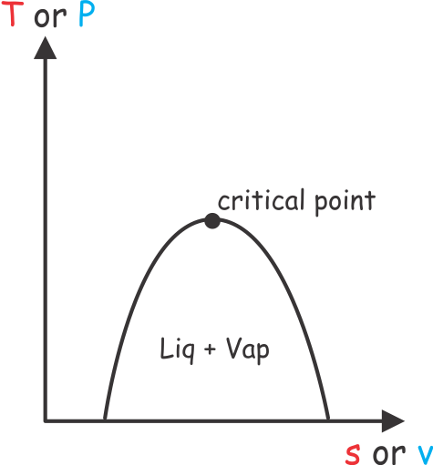
Impact phase relations
Supercritical
Fluid
Vap
Liq
s => entropy
v => volume

Slide 4
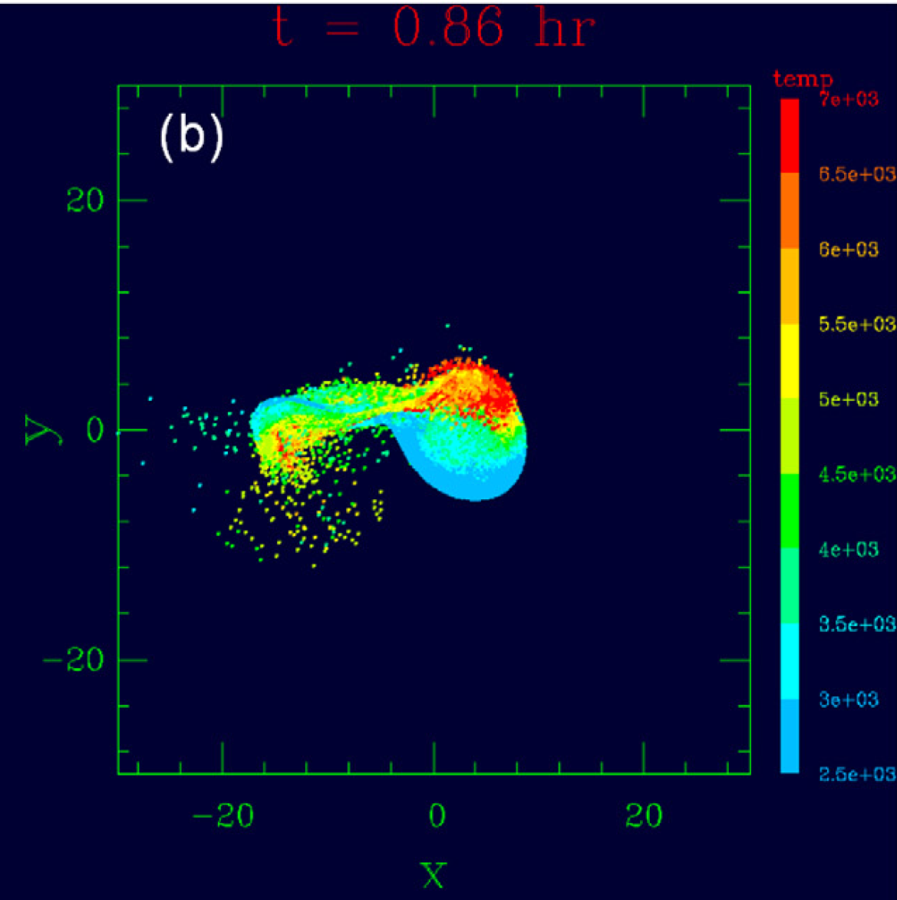
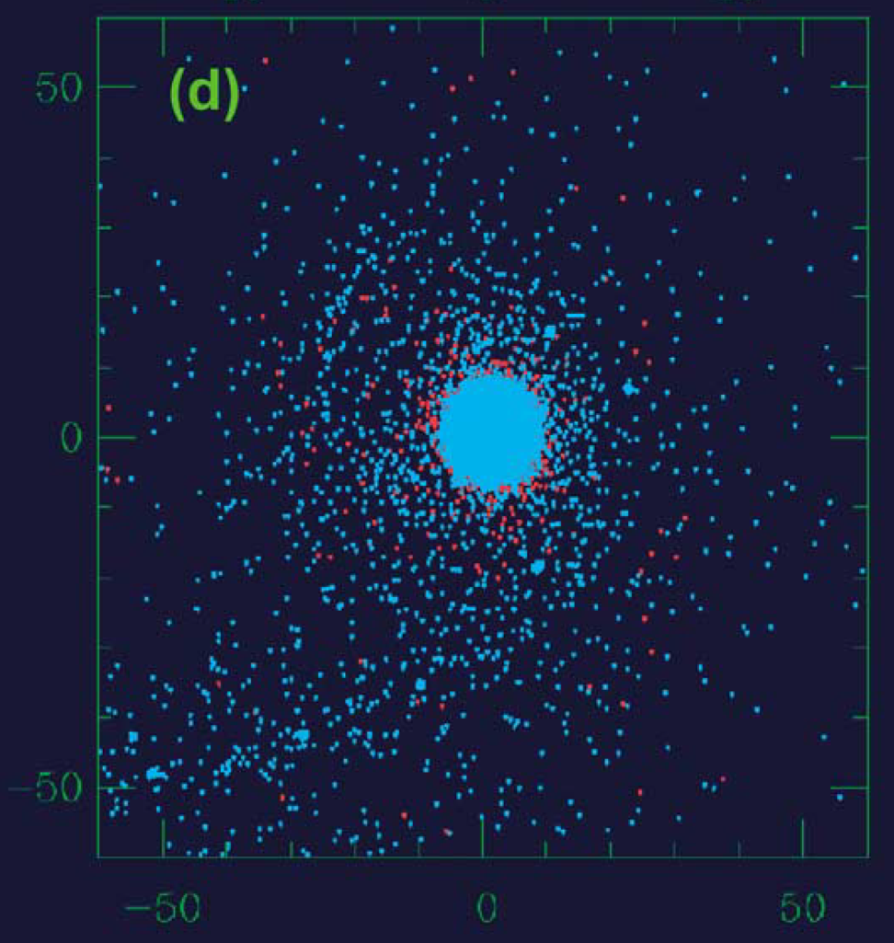
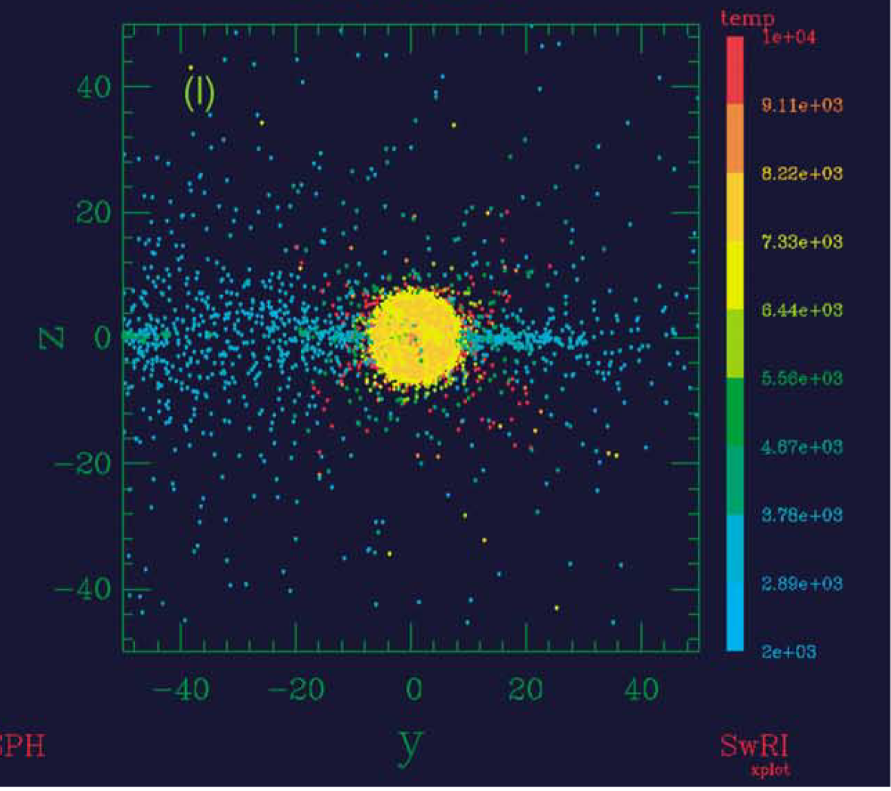
The Standard Impact Model (pre-2013, e.g., Canup 2004)
The day after, temperature, orthogonal to the disk plane
Provenance, in the disk plane
Small (mar-sized), low velocity impactor needed to reproduce the angular momentum of the Earth-Moon system
Obliquity constrained by lunar mass
impactor
earth
10000 K
The ejected material originates primarily from the impactor, but the Moon’s isotopic composition is identical to that of the Earth’s Mantle
2000 K

Slide 5
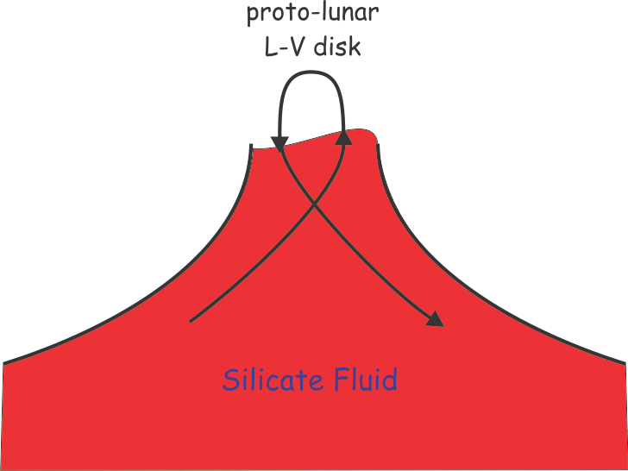
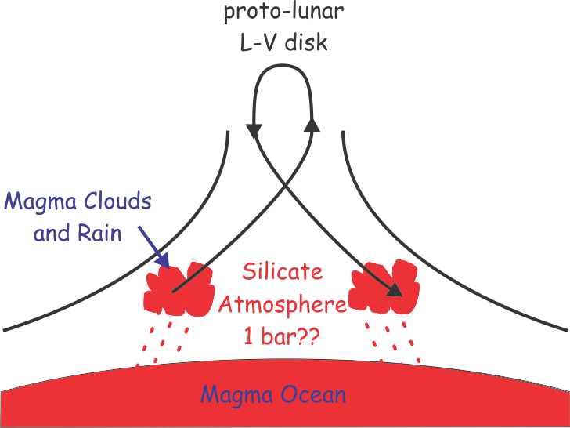
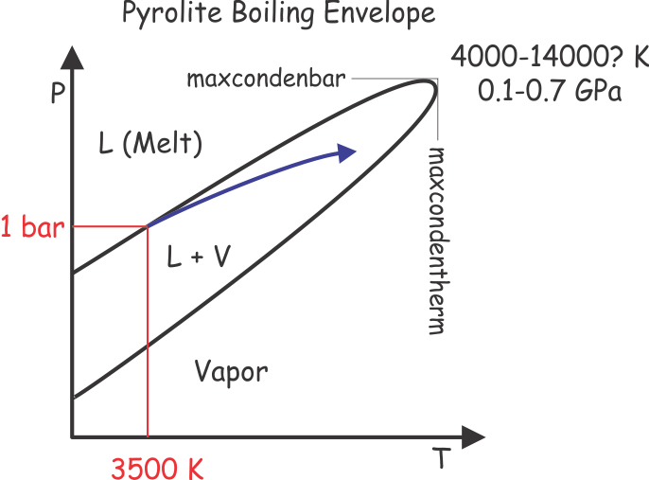
Stevenson’s (1987) solution: post-impact re-equilibration
the rain-out model fails to reproduce Si isotopic composition
the model is too fancy for it’s own good, T can’t be raised because they want to fit highly uncertain chemistry (X_{Mg} from Khan et al. 2006)
A week of post-impact turbulent convection homogenizes the earth-mantle proto-lunar disk system
Pahlevan et al (2011) version of the solution:

Slide 6
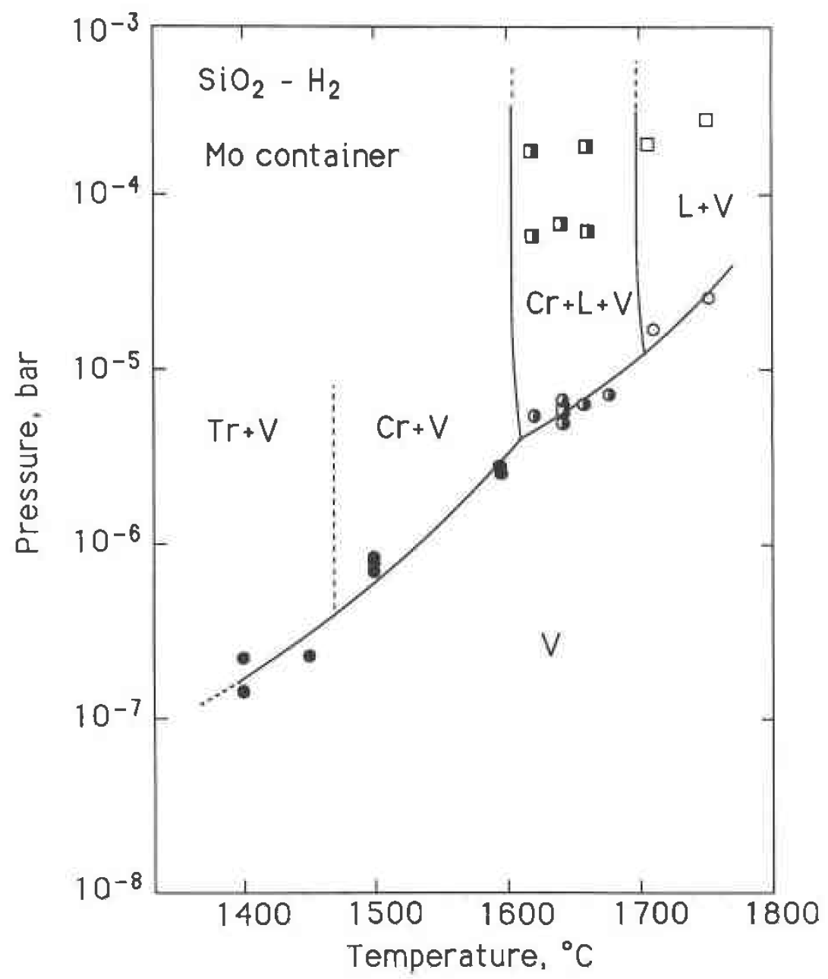
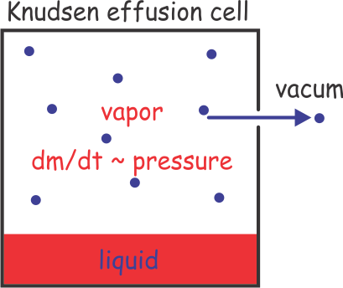
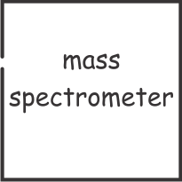
What is known about silica boiling I
At 1 bar various mad scientists have located the boiling point somewhere between 2200-3200 K
More manageable temperatures (1400-2000 K) by working in a low pressure Knudsen effusion cell
Knudsen cell phase equilibria => Mysen & Kushiro (1988)
Locate boiling curve at 10⁻⁵-10⁻⁴ bar
Extrapolates to 3100±150 K at 1 bar
Knudsen cell mass spectrometry => Shornikov et al. (1998-2000)
The gas is molecular (SiO, O₂, SiO₂, Si and O)
Dominantly diatomic (O₂, SiO₂)
Equilibrium constants for gas phase speciation, i.e., for
SiO₂ = SiO + O₂
SiO = Si + O₂
O₂ = 2O

Slide 7
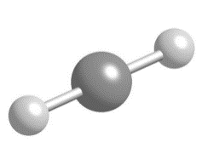
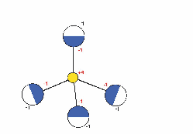
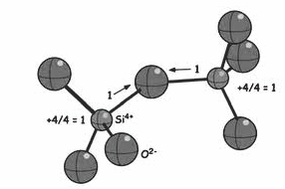
Structure of the Low T Liquid
SiO₂ in the vapor, molecular, 2-fold coordination
The 1 bar melting point is 2000 K, calorimetric and spectroscopic measurements are made on metastable glasses
Calorimetry (Tarasov et al. 1973, Bottinga & Richet 1982)
=>
glass heat capacity at ~1480 K is at the Dulong-Petit limit (3nR) –> harmonic oscillator
Almost no difference in properties between cristobalite and melt + spectroscopy
=>
Si is tetrahedrally coordinated -> melt cannot be molecular
If there is a critical point, the structure of the ionic melt and molecular gas must converge at that point
SiO₂ in the liquid, ionic, 4-fold coordination
SiO₄⁴⁻
Si₂O₇²⁻
etc

Slide 8
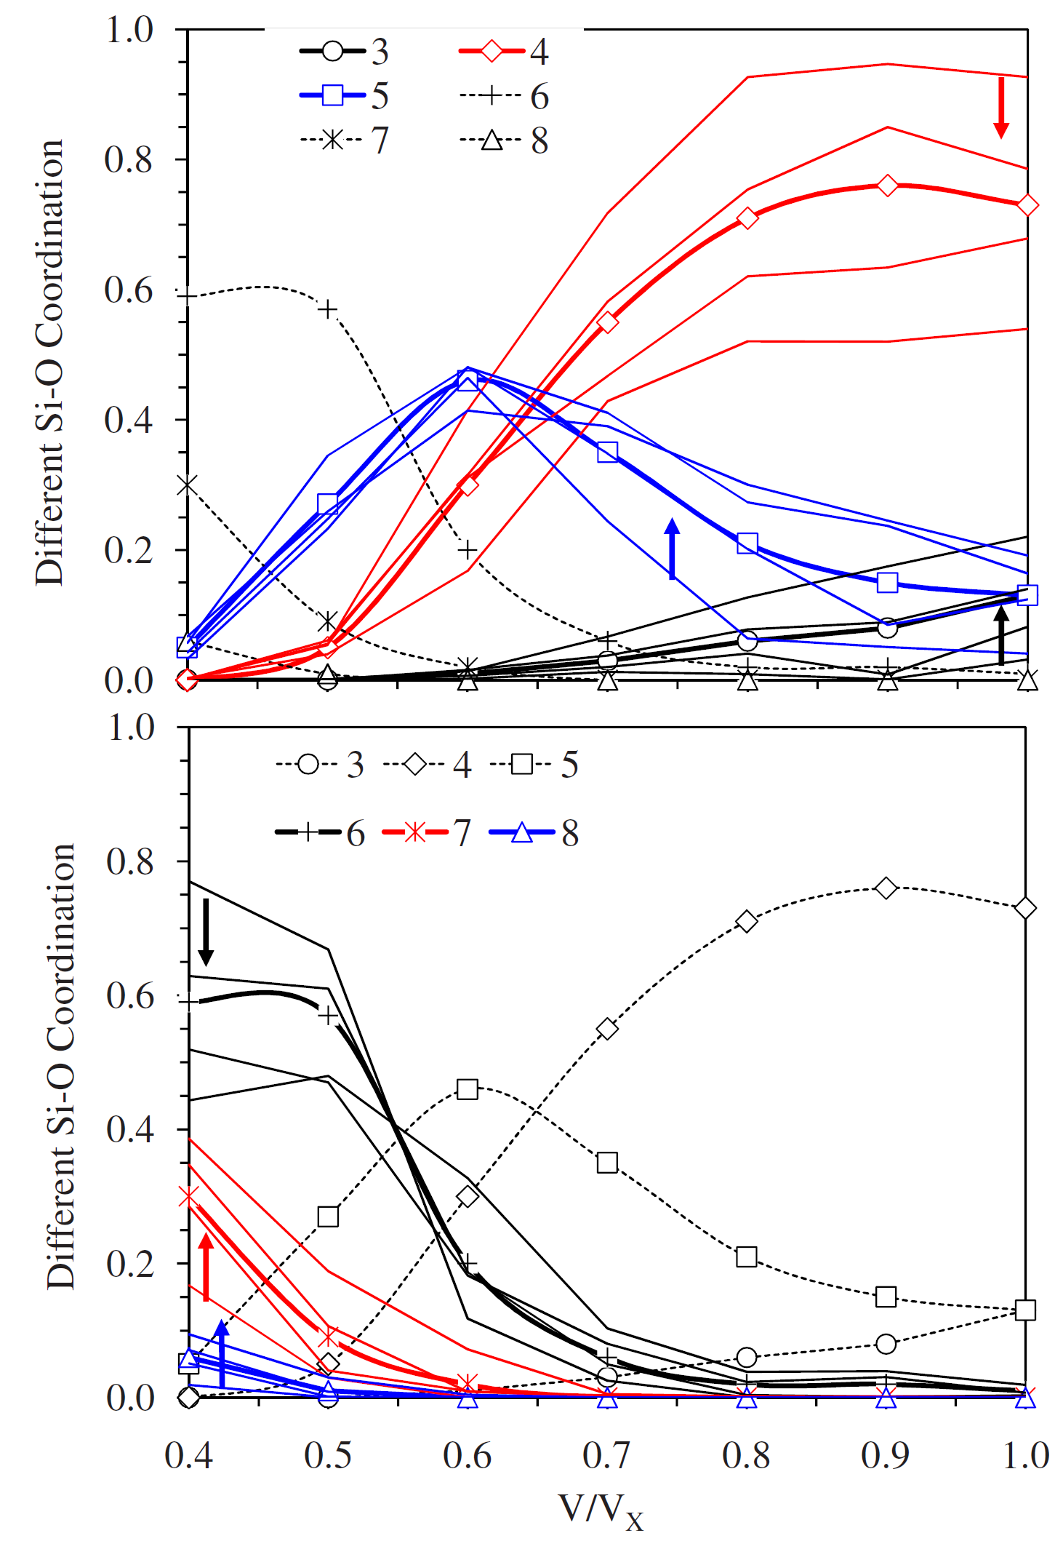
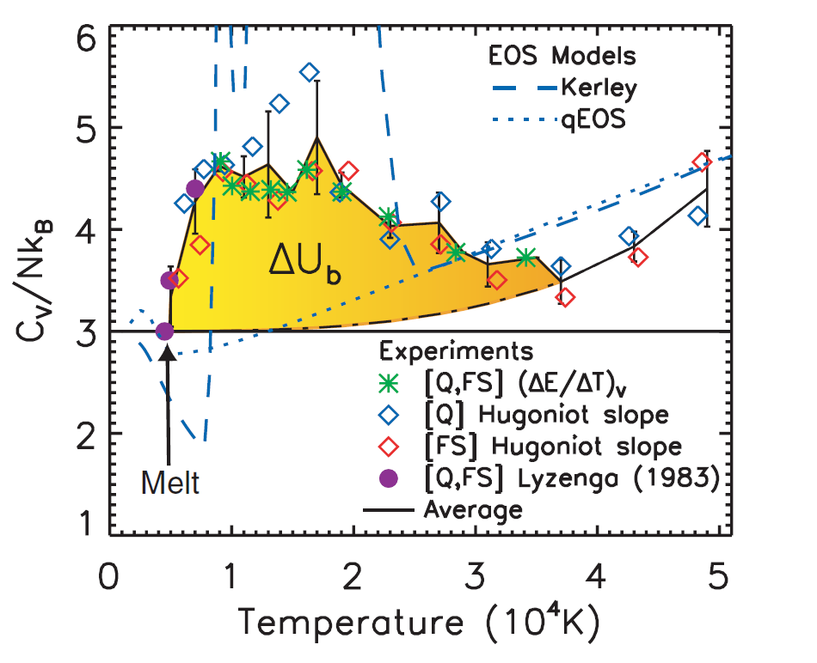
Structure of the High T Liquid
Ab-initio molecular dynamics (Karki et al. 2007) 3000-6000 K, density > ρ_{MP} =>
Si coordination number decreases with increasing volume (temperature)
C_{v} is ~150% of the Dulong-Petit limit
Shock wave experiments (Hicks et al. 2006) =>
strongly anomalous heat capacity that starts at the onset of melting (~4500 K on the quartz Hugoniot)
conductivity evidence for a rapid disorder from 4500-8000 K (far below the plasma transition at ~30000 K)
anomalous heat capacity is probably associated with both bond breaking suggesting the possibility that the melt becomes more molecular with T
no data for Cv on low density liquid, it is improbable that it is constant as assumed in petrological and hydrocode models
decreasing melt density

Slide 9
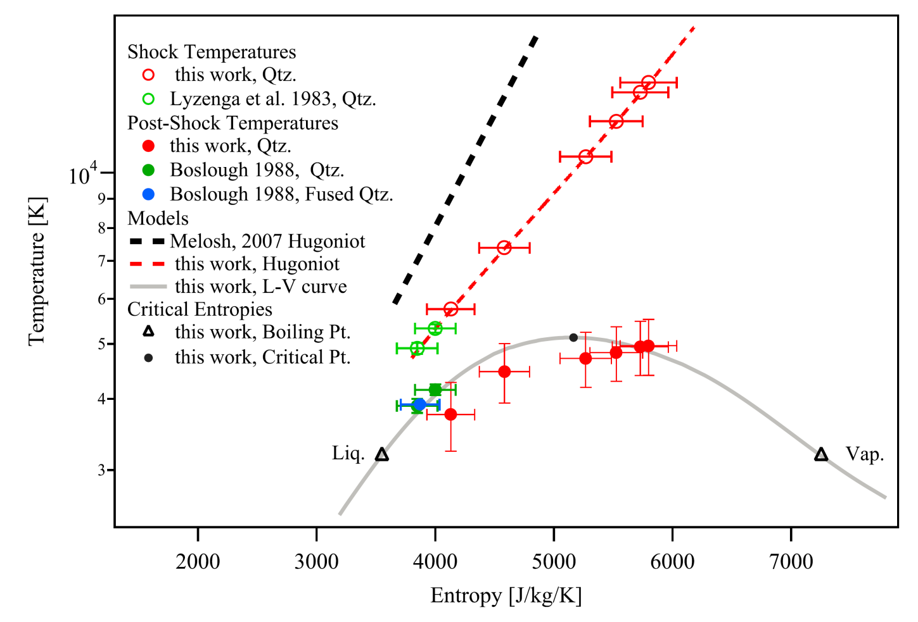
High T Boiling: Shock and Release Experiments (Boslough 1988, Kraus et al 2012)
MANEoS Hugoniot
Experimental Hugoniot
Shock sample hitting it with a laser beam
Monitor T by phonon pyrometry during decompression once the sample begins to boil (~5 ns)
The liquid is relatively opaque so:
in liquid dominated (low T/s) experiments phonons come from the uncompressed state, indicate T <= T_{boil}
in vapor dominated systems (high T/s), the pyrometer samples the compressed state, indicate T >T_{boil}

Slide 10
ANEoS - “Mie-Gruneisen” model for fluids (Thompson 1973)
A = A_{cold} + A_{thermal} + …
A_{cold} = ∫P_{cold} dv => pseudo-Mie potential (Zharkob & Kalinin 1971) =>
P_{cold} = C(f^{m} – f^{n}), f = ρ/ρ₀ < 1, m > n
A_{thermal} => Kormer et al. 1962 =>
(1-Ψ)*A_{Debye model solid} + Ψ*A_{ideal monatomic gas}, 0 ≤ Ψ(ρ,T) ≤ 1
Underestimates vaporization => Overestimates impact temperatures
Melosh (2007, Bobrovski et al. 1974) modified ANEOS for SiO₂
A_{ideal monatomic gas} => Areactive diatomic-monatomic ideal gas mixture
based on the SiO = Si + O partition function, the correction doesn’t define speciation rather it loosely captures its entropic and energetic consequences
Parameterized to locate the critical point along the extrapolation of the low P boiling curve at which
PV/nRT ~ 0.3
a prediction for single species fluids from the “law of corresponding states”, n is the moles of molecules in a mole of SiO₂ fluid, i.e., 1 ≤ n ≤ 3
this prediction does not apply for mixed species and n is guessed
=>
the parameterization assumes the answer

Slide 11
MANEoS II
neglects (accurately known) gas speciation; assumes Dulong-Petit limit liquid heat capacity.
Consequently it:
overestimates the extent of melting by ca 50%
Hugoniot T-s curves are 5000-20000 K too low
lowers vaporization T but its accuracy cannot be assessed
allows no compositional degrees of freedom, i.e., SiO₂ fluid must be stoichiometric

Slide 12
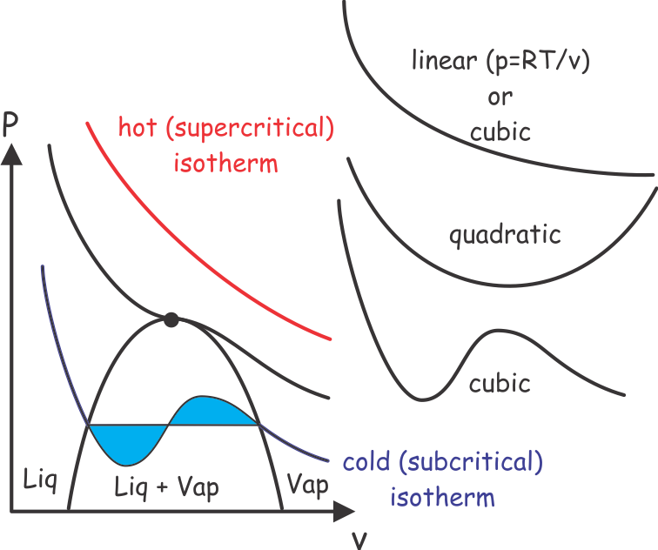
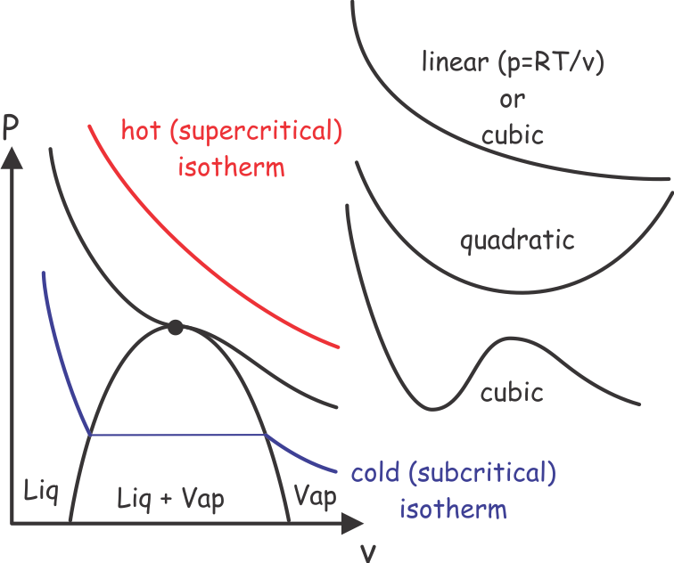
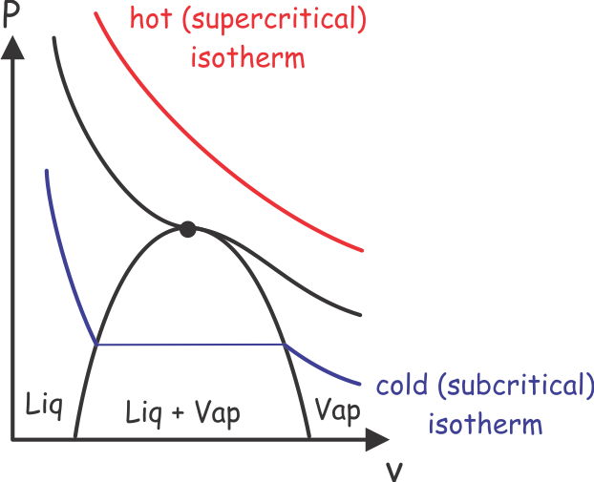
Sowaddahamigonnadoaboutit?
Van der Waals-type molecular EoS: 2-parameter cubic f(v)
Redlich-Kwong EoS
P = RT/(v-b) – a/vT^{1/2}(v+b)
impure fluid: a = f(y_{i},a_{i}), b = f(y_{i},b_{i})
need 10 parameters (a_{SiO2}, a_{SiO}, a_{Si}, a_{O2}, a_{O}, b_{SiO2}, b_{SiO}, b_{Si}, b_{O2}, b_{O})
+ known thermodynamic properties of the ideal gas limit
cannot be used at high pressure, i.e., if v < b

Slide 13
Pure species parameters
O₂ – at a critical point
∂P/∂v = 0, ∂²P/∂v² = 0
known O₂ critical conditions => 2 equations in 2 unknowns (a _{O2}, b_{O2})
O – approximate by a_{O2}, b_{O2}
Si, SiO₂ – at the (known) 1 bar melting points (Si, 1687 K; SiO₂ 1999 K)
v_{liq} = ∆v_{melting} + v_{sol}
g_{sol} = g_{liq} = g_{gas} + RTln f_{liq}
P_{mp} = RT_{mp}/(v_{liq}-b) – a/v_{liq}T_{mp}^{1/2}(v_{liq}+b)
ln f_{liq} = b/(v-b) – a[1/(v_{liq}+b) + ln{(v_{liq}+b)/b}/b]/RT_{mp}^{3/2} + RT_{mp}/(v_{liq}-b)
SiO – guess from SiO₂ by analogy with CO and CO₂, a_{SiO} adjusted to match low T oxygen solubility in Si melts

Slide 14
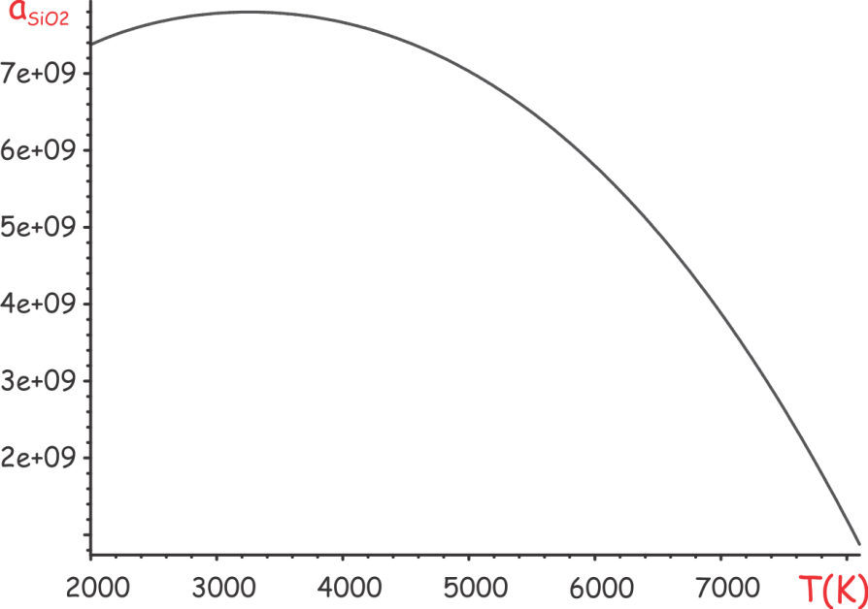
Is the a parameter temperature dependent?
at high T gas species heat capacities are near constant, liquid heat capacity cannot be < the Dulong-Petit limit
For RK in dense limit (v_{liq}->b, α->0) this requires
a ≥ 8RbT^{3/2}/(3+6ln2)
too strong to ignore
g_{melt} -> a_{MP}
s_{melt} = -∂g_{melt}/∂T -> (∂a/∂T) _{MP}
∆Cp_{melting} = -T ∂²g_{melt}/∂T² -> (∂²a/∂T²) _{MP}
=>
a = f(T)

Slide 15
Impure fluid a & b parameters
b = ∑y_{i}b_{i} – theory (virial EoS)
a – assume molar weighted sum of pair-wise interactions
a = ∑ ∑ y_{i}y_{i}[a_{ij}]
[a_{ij}] estimated by harmonic, geometric or arithmetic mean of a_{i} & a_{j}
Experimental data (Schnurre et. al 2004) for low T, 1 bar, Si-SiO₂ mixtures provide a test via the Henry’s law coefficient k_{SiO2} in Si melt:
T, K | Exptl k_{SiO2}, J/Pa | k_{SiO2} Arithmetic Mean | k_{SiO2} Geometric Mean | k_{SiO2} Harmonic Mean
1700 | 453 | 460 | 413 | 351
1850 | 471 | 472 | 402 | 362

Slide 16
The Stable Speciation in the Si-O System
Speciation for a given bulk composition (e.g., SiO₂) pressure and temperature is computed from 5 equations in the 5 unknown species fractions (y_{SiO2}, y_{SiO}, y_{Si}, y_{O2}, y_{O}):
Closure: y_{SiO2} + y_{SiO} + y_{Si} + y_{O2} + y_{O} = 1
2) Bulk Composition: X_{O} = n_{O}/(n_{O}+n_{Si})
n_{O} = y_{O} + 2 y_{O2} + y_{SiO} + 2 y_{SiO2}
n_{Si} = y_{Si} + y_{SiO} + y_{SiO2}
3-5) Internal equilibrium by speciation reactions:
SiO₂ = SiO + O₂, K₁ = y_{SiO}y_{Si}/y_{SiO2}*f₁(P,T,y_{i})
SiO = Si + O₂, K₂ = y_{O2}y_{Si}/y_{SiO}*f₂(P,T,y_{i})
O₂ = 2O, K₃ = y_{O2}/y_{O}²*f₃(P,T,y_{i})

Slide 17
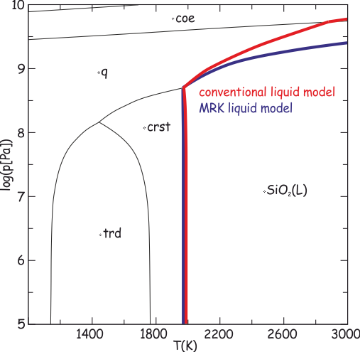
Does it work?
Test I: Comparison to conventional petrologic melt model
Good to ~1 GPa
ρ_{max} ~ 2350 kg/m³

Slide 18
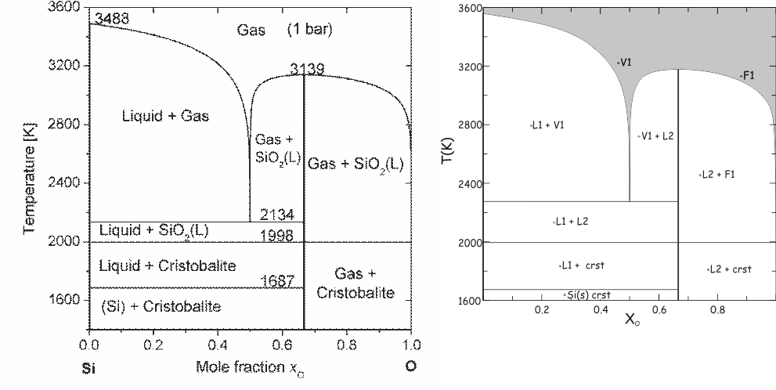
Does it work?
Test II: Comparison to low P phase relations as function of composition
Schnurre et al (2004), 2 liq EoS + ideal gas vapor
MRK

Slide 19
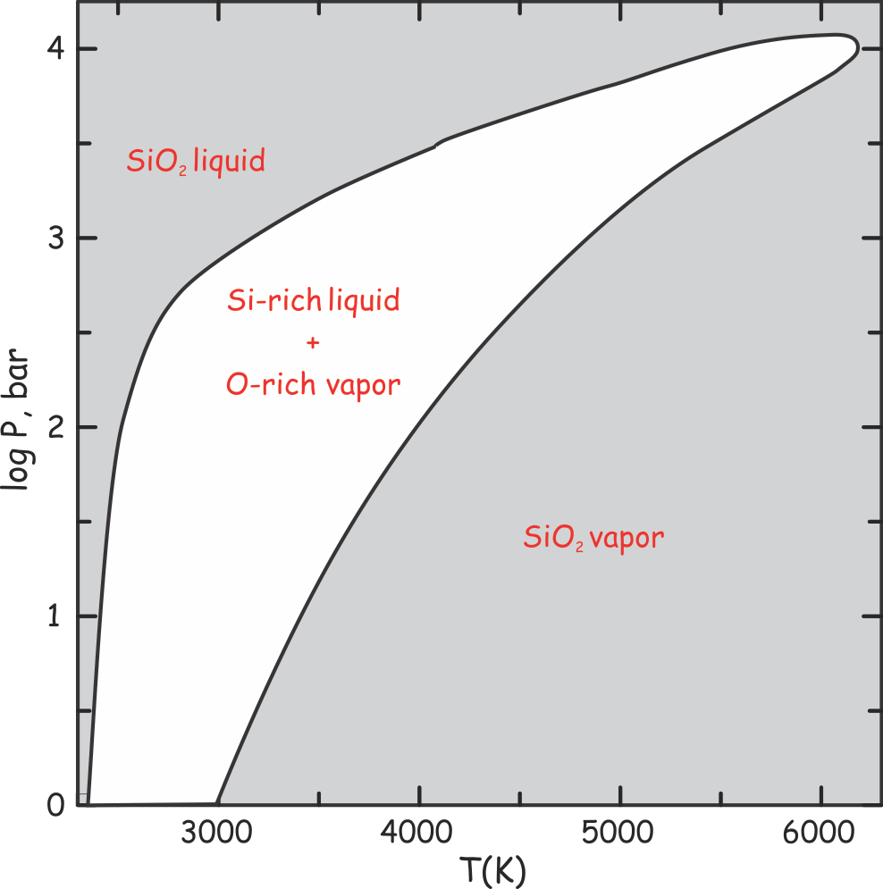
Prediction 0: the boiling curve

Slide 20
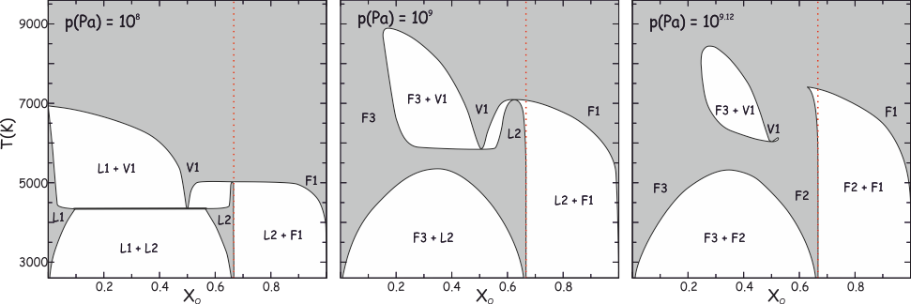
Prediction I: What happens with increasing pressure…

Slide 21
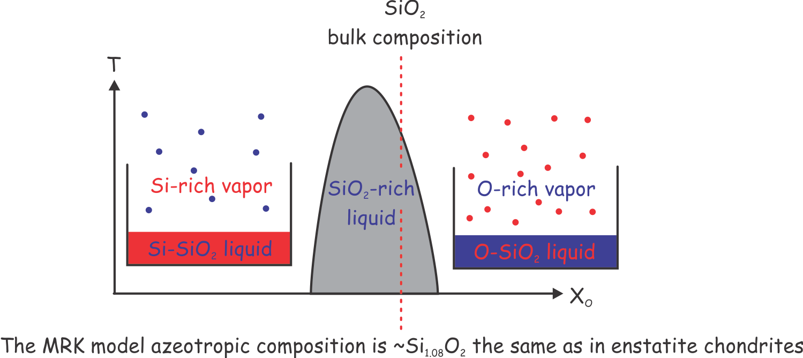
Is azeotropic boiling plausible?

Slide 22
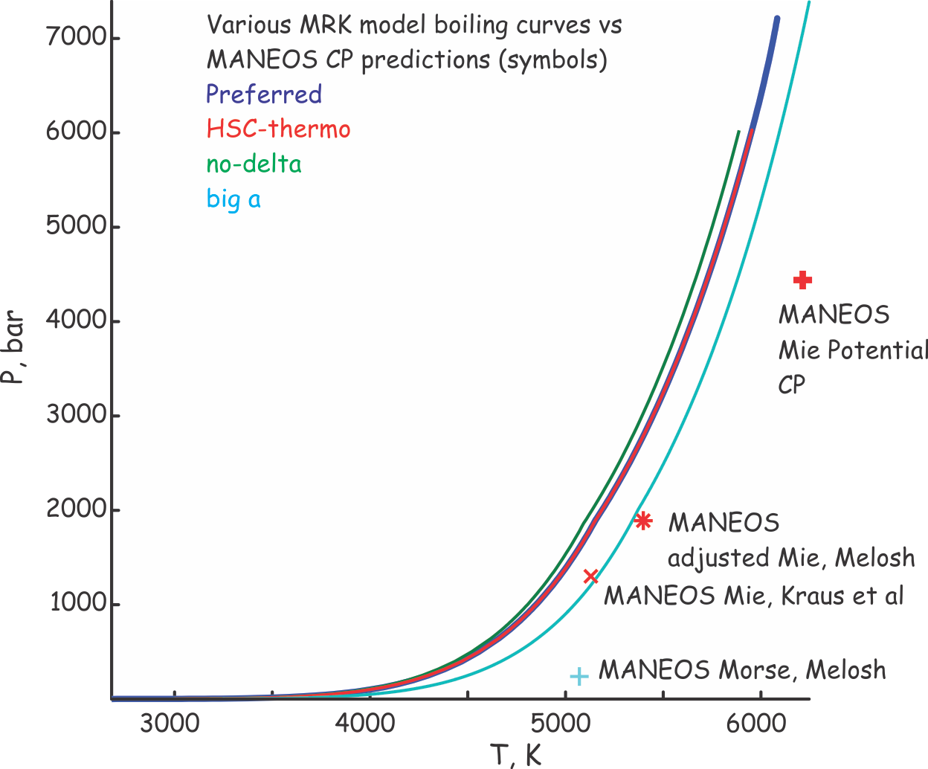
Prediction II: boiling curves

Slide 23
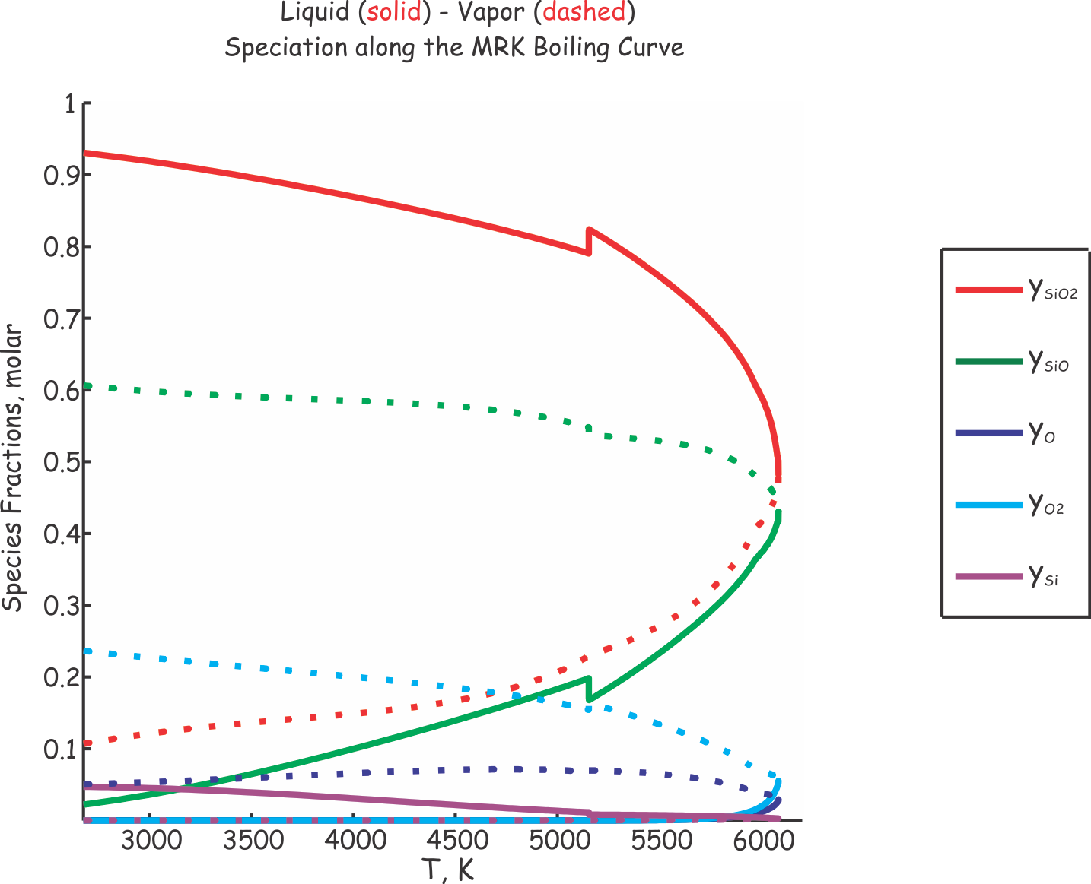
Prediction III: speciation

Slide 24
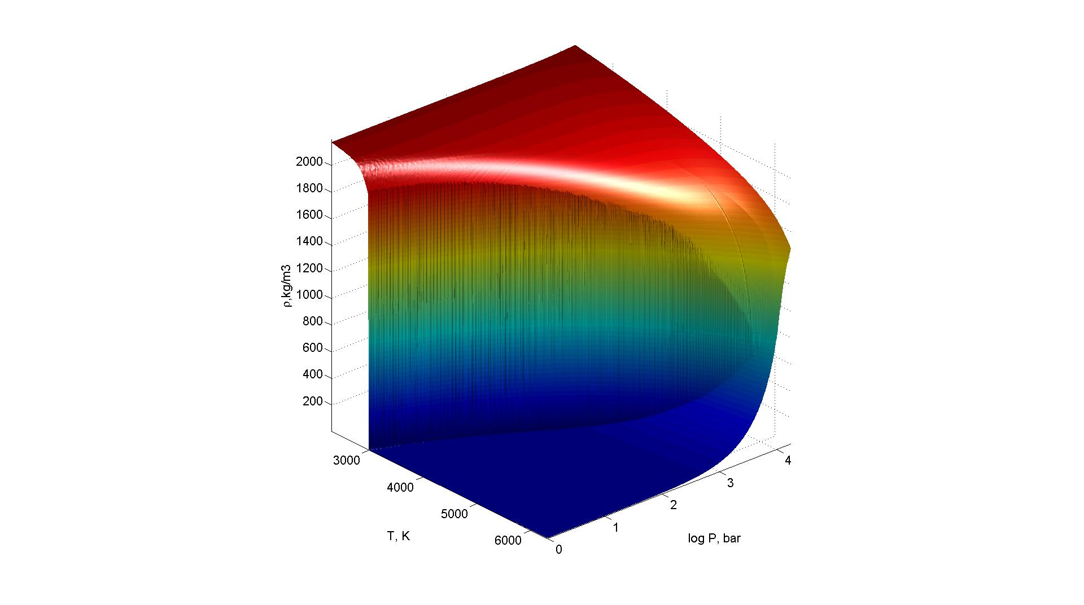
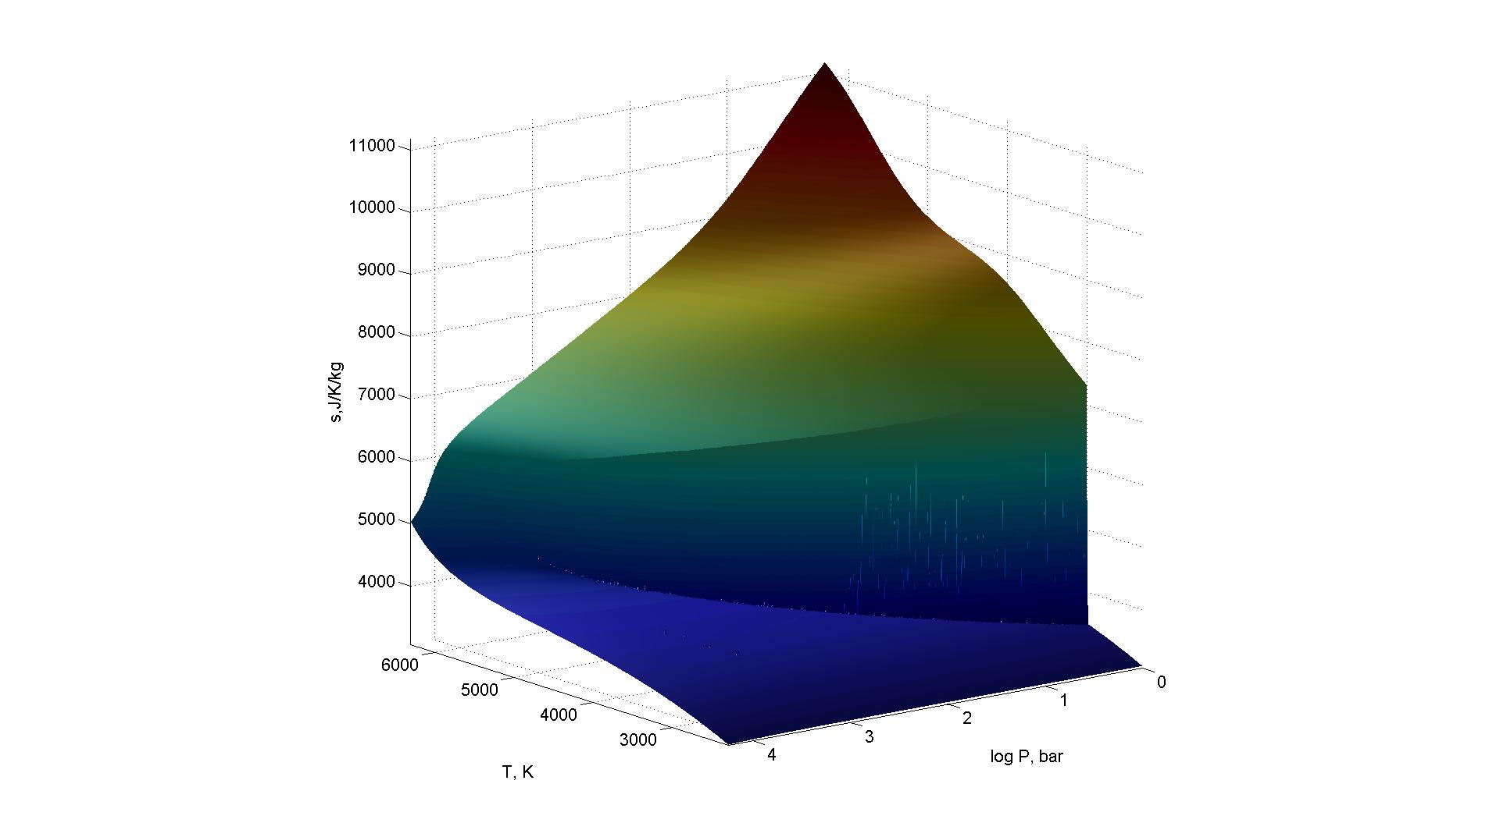
Prediction III: speciation

Slide 25
The Scales of Stevenson’s Scenario (Pahlevan & Stevenson 2007) for a 6000 K Earth
Rotation doesn’t isolate the protolunar disk
τ_{cool} = Gm_{E}m_{I}/σ_{sb}T⁴4πr_{E}³ for T ~ 2000 K -> 3000 years for earth, 1000 years for the disk => decreases ~ 10 years
τ_{conv} = L^{2/3}/(F/ρH)^{1/3} turnover time mantle ~ 1 week, disk, atmosphere ~ hours => decreases ~ 1 day
τ_{exchange} = σ(3kT/m)^{1/2}Pα mass exchange at the disk/earth interface ~ several lunar masses per week => decreases to a couple of masses
A lot less favorable, but τ_{conv} << τ_{exchange} and τ_{exchange} << τ_{cool} so a first guess is that a supercritical earth model is plausible

Slide 26
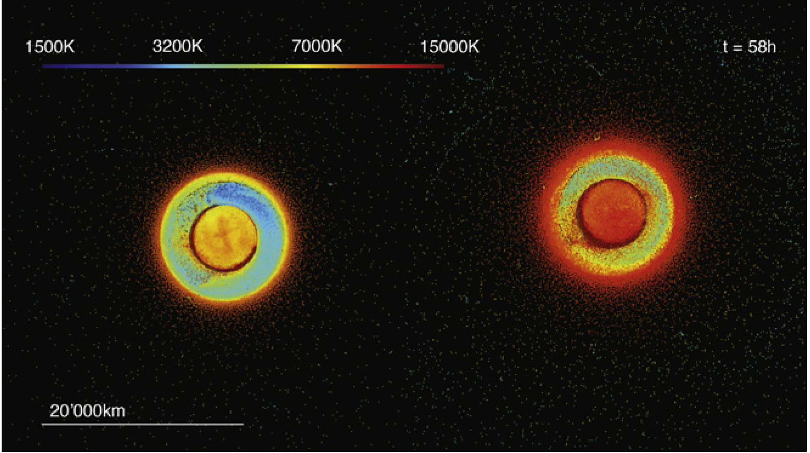
Post-2011 Impact Models
Cuk & Stewart (2012) the Earth-Moon system could have lost angular momentum through resonance with the Sun => the loss of the angular momentum constraint has spawned an avalanche of new impact models, to name a few:
Small impactor + rapidly spinning earth reanimates Darwinian fission (no chemical problems, Cuk & Stewart 2012)
Giant-giant (Earth sized) impactor averages the impactor and target mantles (no chemical problems, Canup 2012)
Hit-and-run high velocity impactor (chemical problems, but vastly hotter post-impact Earth, Reufer et al 2012)
post-impact Earth temperature
Pre-2011
“Canonical” Model
Reufer et al 2012
Hit-and-Run Model

Slide 27
Conclusions
The MRK provides a simple model capable of both connecting silicate liquid and gas states and reconciling low P data
The model can easily be extended to more complex chemical systems
Non stoichiometry of silicate boiling suggests that a multiple impacts and atmospheric loss could lead to significant metal enrichment, the enstatite chondrite Si/SiO₂ ratios are consistent with the azeotropic composition of the MRK SiO₂ boiling curve
The MRK critical point is at similar T to that of the MANEOS, Stevenson’s (1987) post-impact equilibration scenario remains plausible for a super-critical Earth

Slide 28
dK/dT < 0 only if a > a₀ (T/T₀)^{5/2}

Slide 29
The Microscopic Structure of the Liquid
1 bar MP 2000 K
Calorimetry (Bottinga & Richet) =>
Cp_glass = 3nR -> the DP limit at 1480 K – Harmonic Os
Almost no difference in properties between Cristobalite and Melt,
Si is tetrahedrally coordinated, the Melt must be ionic!
Ottonello et al (2010) explain these observations with a model in which a crystal-like network of Si4O8 units is interpersed with liquid like SiO4= in 2:1 proportions. The 1R Cp_glass-Cp_liq jump is due to rotational-translational degrees of freedom. Flat Cp justified by partial molar Cp to ~1800 K
Many other models, but any model with Si CN > 2 implies ionic species
Ab-Initio MD study (Karki et al 2007):
CN decreases with increasing volume (temperature)
Cp is 150% of the DP limit
Calculations at high T, but only at high density (rho>rhomeltingpt)

Slide 30
The Microscopic Structure of the Liquid II
Shock wave expts (Hicks et al 2006) indicate a strongly anomalous heat capacity that starts at the onset of melting (~4500 K on the qtz Hugoniot)
Primarily temperature dependent, conductivity evidence for a rapid disorder from 4500-8000 K (far below the plasma transition at ~30000 K)
=>
Low T silica melt is ionic, CN > 4
It has strongly anomalous Cp (150% CDP) that is probably associated with both bond breaking, at low pressure increase in T correlates inversely with CN, suggesting the possibility that the melt becomes more molecular.
There is no data for Cv on low density liquid, it is improbable that it is constant as assumed in petrological and hydrocode models

Slide 31
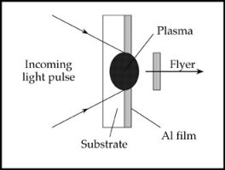
Shock and release experiments
Shock sample by shooting it out of a cannon or hitting it with a laser beam
For a given initial state the final state is solely a function of the impact energy
Decompression is fast (~5 ns) nearly elastic
Low entropy (< Scrit) experiments record T <= Tboil, high entropy experiments

Slide 32
Hydrocode EoS
ANEOS – Mie Gruneisen model (Thompson 1973)
A = Acold + Athermal
Acold => Pcold = C(f^m – f^n), f = rho/rho0 => Zharkob & Kalinin 1971
Athermal = Debye Model + f(Y(rho,T)) => Korner et al 1962
Y = 0 => solid Y=1 gas
Parameterized by fitting the theoretical energy for a monatomic gas in the infinite T limit
Underestimates the extent of vaporization because in most cases much less energy is required to vaporize a solid to diatomic or more complex molecules

Slide 33
So What’s the Deal
The ionic liquid model and the molecular gas model, both of which are supported by experimental evidence, must converge at the critical point
Modeling the ionic limit would require introducing new gas phase species for the gas phase, there is no experimental evidence for such species, ergo the simplest limit is the molecular limit, i.e., to assume that the melt becomes increasingly molecular along the boiling curve
In this case, we have 5 species possible in both phases and the speciation in

