Slide 1
Experimental Studies of the Permeability (k) and Viscosity (ζ) of Crystal Mushes
Max Schmidt (ETH)
Melanie Forien (Frankfurt)
Guilio Solferino (ETH)
Nick Bagdassarov (Frankfurt)
Sharzad Manoocheri (ETH)
Guiliano Kraettli (ETH)
Notes:
Many processes generate pervasively distributed fluid

Slide 2
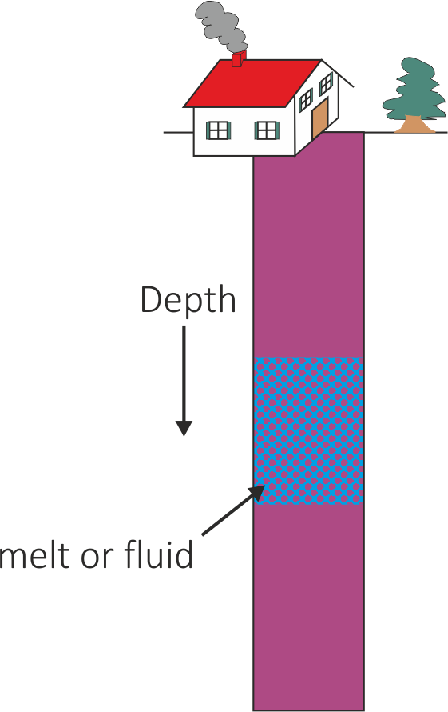
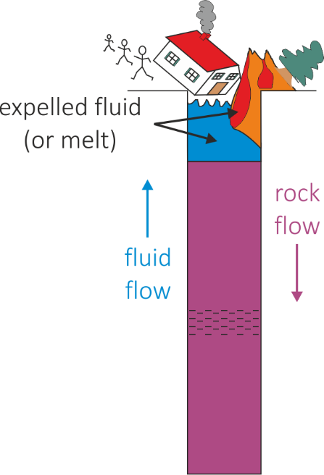
Should you care about crystal mushes?
You should care about fluid expulsion
k – matrix permeability
ζ – matrix bulk viscosity
McKenzie 1984, etc
Notes:
Many processes generate pervasively distributed fluid

Slide 3
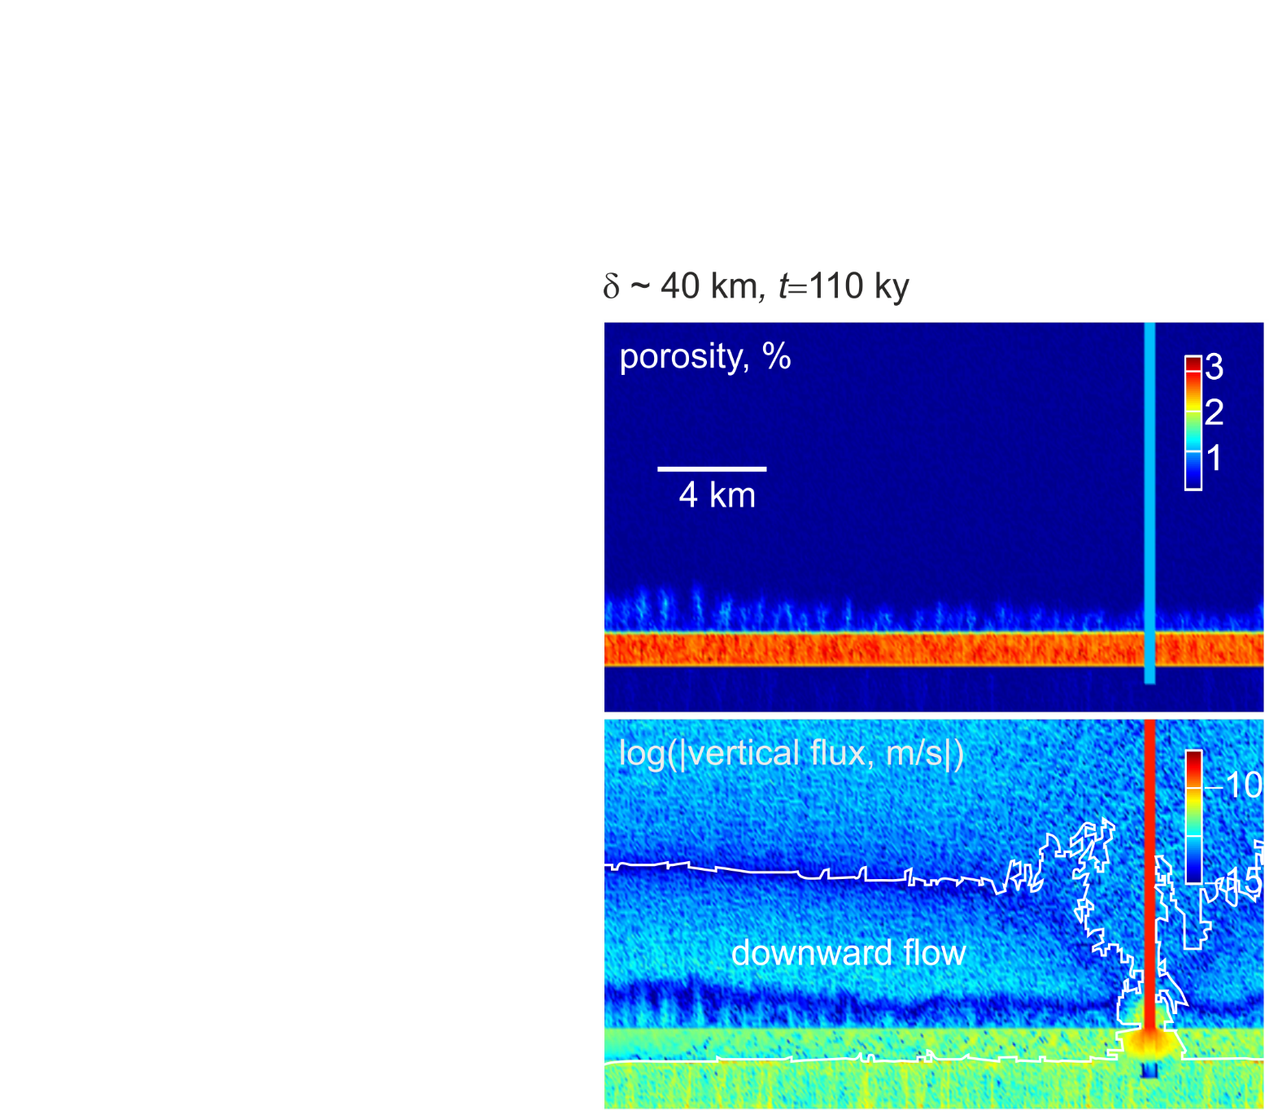
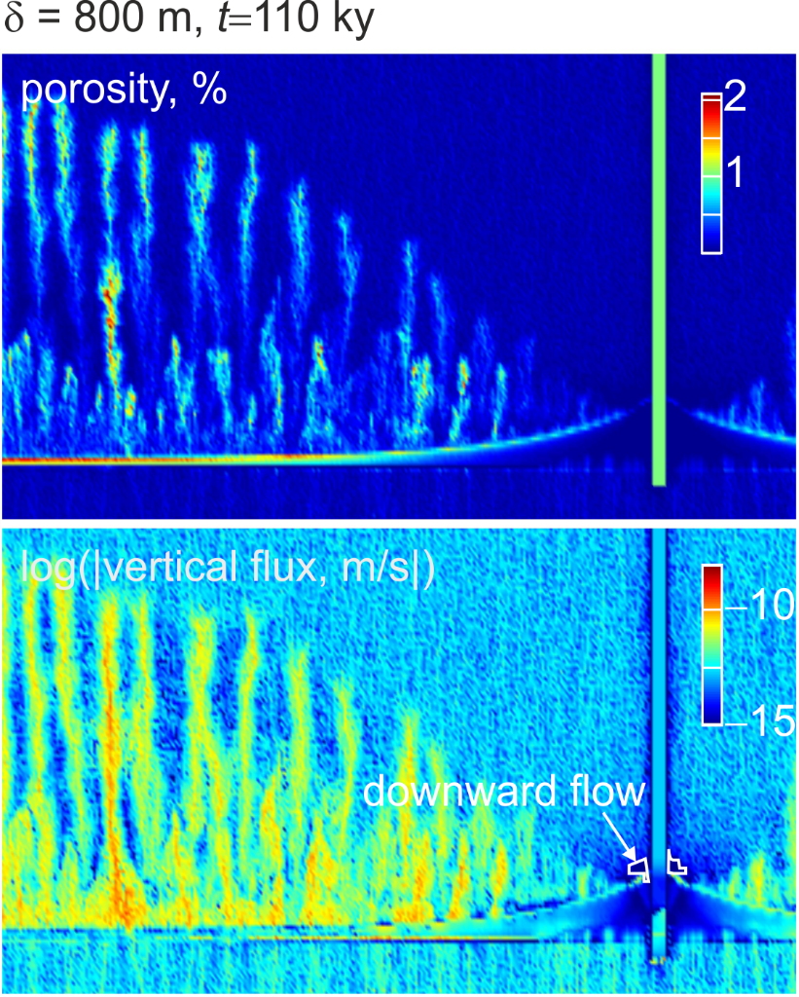
A numerical illustration: fluid flow above a metamorphic dehydration reaction
high viscosity
low viscosity
Connolly, Elements, 2011

Slide 4
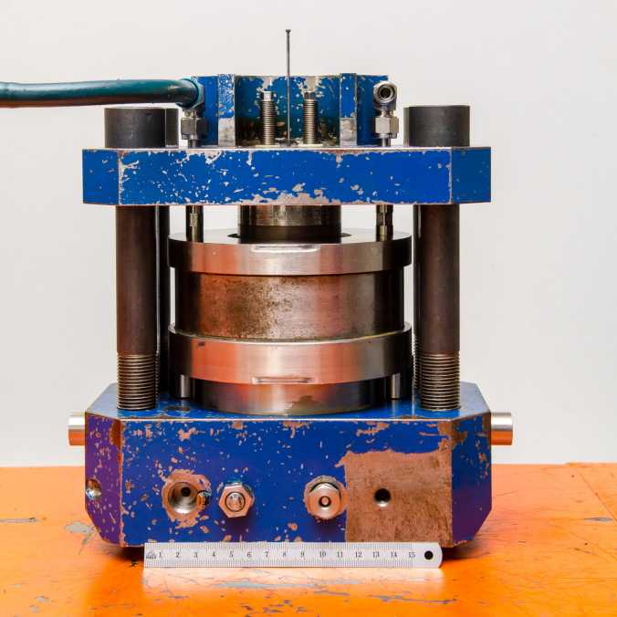
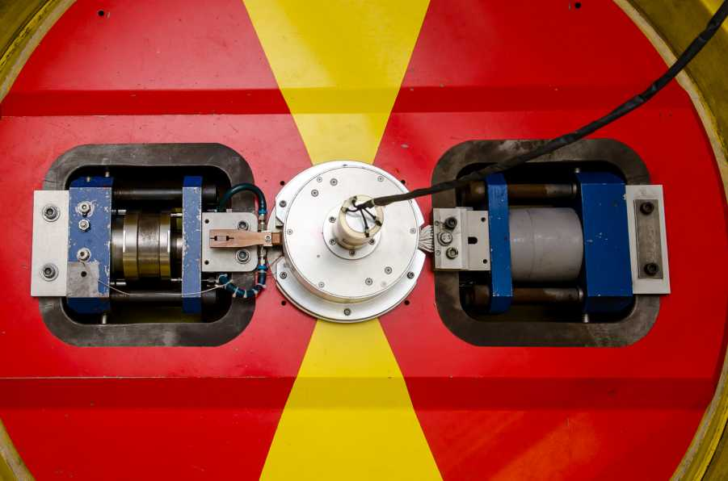
Outline
The two imiting compaction scenarios
Corresponding compaction experiments and analysis thereof
Implications
The centrifuge – 1.4 m diameter table, 1 ton, outer edge rotating at 800 km/h
Schmidt, Connolly, Guenther, & Bogaerts; Science, 2006

Slide 5
Limiting (Self-)Compaction Regimes
What causes compaction?
p_{e} = p_{total} − p_{fluid}
φ₀
pressure
p
porosity
φ
h₁, t₁
h₀ << δ₀
rheologically-limited
fluid flux negligible
observation constrains ζ
h₂, t₂
t₀
concave
h₀
z
p_{fluid}
p_{total}
z
z
φ₀
pressure
p
porosity
φ
hydraullically-limited
p_{e} negligible
observation constrains k
h₁, t₁
h₀ >> δ₀
h₂, t₂
p_{e} » 0
p_{total} = p_{fluid} = p_{solid}
convex
z
z
Notes:
Instantaneously sedimented self-compacting column
1) Top porosity doesn’t change with time, concave profile
2) Only smooth solution is that the column drains from the bottom up. Convex profile. Why? Max entropy production.

Slide 6
Part I: Hydraulically-limited (k) Centrifuge Experiments
The idea:
Permeability increases exponentially with porosity (φ) ->
Low porosity experiments will be hydraulically-limited and isolate permeability
The details:
Cylindrical (h = 2 mm, r = 1 mm) olivine-basalt-liquid charges, liquid fraction 5-12%
Annealed 24 h prior to centrifuging
Centrifuged 4-10 h at 400-700g to induce compaction, 1300°C, 0.9-1.4 GPa, post-run grain size 21±9 μm
Connolly, Schmidt, Solferino, & Bagdassarov; Nature 2009

Slide 7
The results:
No crystal-free zone at the top -> compaction is not hydraulically-limited
Connolly, Schmidt, Solferino, & Bagdassarov, Nature 2009

Slide 8
The story:
original theory c_{k} = 220
McKenzie 1984: c_{k} = 50-1000
Analysis of Renner et al. (2003) Ol-MORB experiment: c_{k} ~ 500
Connolly, Schmidt, Solferino, & Bagdassarov; Nature 2009
Notes:
If linear profile with no separation: the profile pivots on the barycenter of the sample
4 unknowns, set diff(pe) = 0 this corresponds to the max fluid pressure possible

Slide 9
Part II: Rheologically-limited (ζ) centrifuge experiments
Basalt liquid-crystal suspensions centrifuged at 400-700g to induce settling and compaction, 1300°C, 0.1-1 GPa, annealed grain size 10-15 μm
3 projects
Olivine – Schmidt, Forien, Solferino, & Bagdasarov (EPSL 2012)
Chromite – Manoocheri & Schmidt (CMP 2014)
Plagioclase – Kraettli & Schmidt (CMP 2021)
Connolly & Schmidt; JGR 2022

Slide 10
Macroscopic viscous rheology
Pure solids: shear viscosity (η), no bulk viscosity (ζ)
Porous granular solids:
macroscopic Newtonian bulk viscosity (ζ) due to compaction of grain-scale porosity (φ)
accomplished by microscopic shear -> ζ = f(η_{solid}, φ)
microscopically Newtonian?

Slide 11
The microscopic comedy of macroscopic Newtonian rheology
Newtonian creep – geodynamics
Diffusion creep – rock mechanics
solid deforms as a fluid
dislocation creep ->
non-linear stress dependence
solid is rigid
deformation by diffusive mass transfer
grain-boundary diffusion creep
ζ = f(η_{solid},φ) => φ → 0, ζ → ∞
ζ = f(η_{solid},φ) => φ → 0, ζ → η_{solid}

Slide 12
What’s supposed to happen (without compaction):
t₀
t₁
The sedimentary porosity, φ_{sed}, is identical to the disaggregation porosity, φ_{d}.
φ_{sed} is a proxy for grain coordination number (CN):
CN » 14 Þ φ_{sed} » 36%
CN » 5 Þ φ_{sed} » 60%
φ_{sed} is preserved at the top of the sediment column even if compaction is turned on
φ_{sus}
φ_{sed}
Grain contact area is a f(φ/φ_{d}):
φ/φ_{sed} ® 0 Þ ξ ® ξ_{solid}
φ/φ_{sed} ® 1 Þ ξ ® 0
It is identical to the matrix disaggregation porosity (φ_{d}) and it is going to be path dependent
φ ® φ_{sed} Þ ξ ® 0, the initial stage of compaction must be hydraulically-limited
Grain contact area (Takei & Holtzman 2013)
Notes:
Settling of a uniform suspension, the sedimentary pile grows from the base upward, while a crystal-free zone grows from the top downward.
The sedimentary porosity is of interest because it’s the threshold between a coherent solid matrix, something with strength, and a suspension.

Slide 13
The Experiments: A result
Olivine, annealed 24 h, centrifuged 5 h @ 1500g, p_{e} ≈ hΔρa ≈ .03 bar = 3 kPa
flattened grain contacts
residuals suggest a concave profile
Schmidt, Forien, Solferino, & Bagdasarov; EPSL 2012

Slide 14
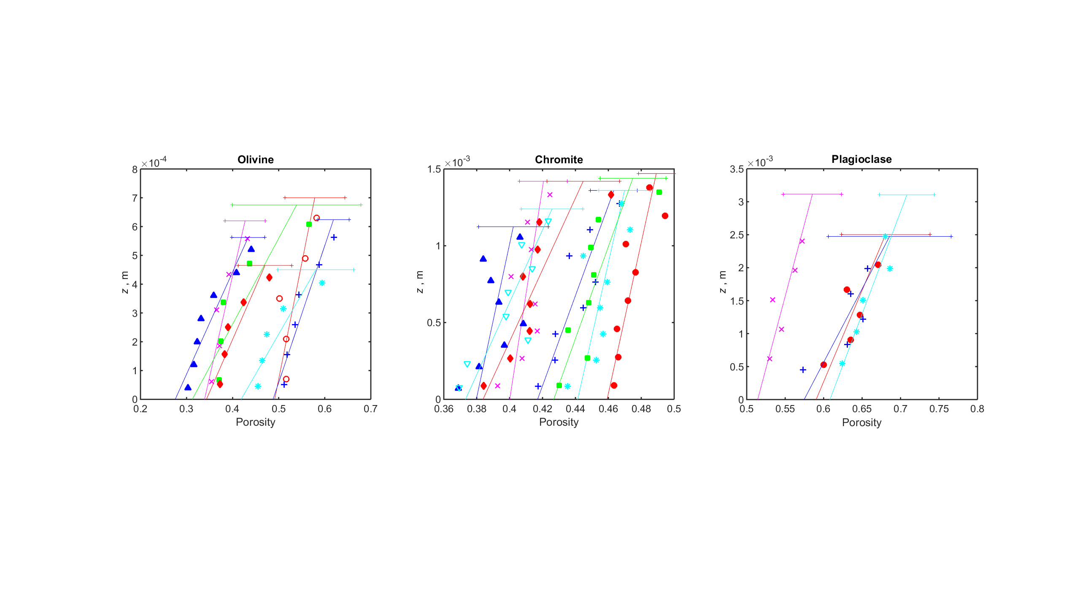
More (19) results
They all compact. Olivine profiles consistently concave; plagioclase and chromite don’t resolve curvature
Compaction is time-dependent (aka viscous)
Profiles don’t extrapolate to the sedimentary porosity (φ_{sed})
Connolly & Schmidt; JGR 2022

Slide 15
Is the mechanism melt-assisted grain-boundary diffusion controlled (GBD) creep?
Compaction is undetectable in “failed” olivine + sulfide-melt experiments (φ = 20-40%, Solferino 2008)
=>
silica solubility is negligible in sulfide liquids
diffusion through the melt is essential to the compaction mechanism
the mechanism cannot be dislocation creep or bulk diffusion

Slide 16
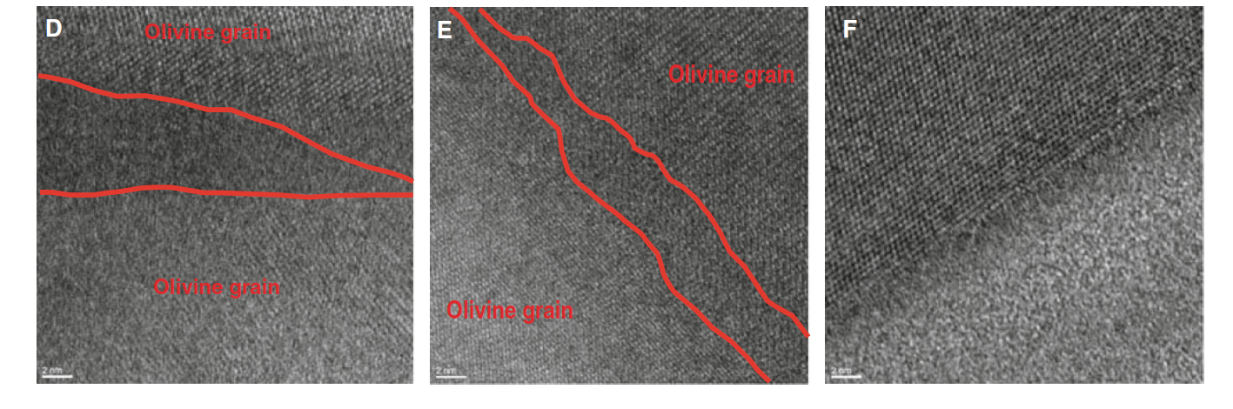
If creep is grain-boundary diffusion-controlled, grain boundaries must be melt-free
=>
Olivine
Melt
Schmidt et al. (2012)
The mechanism is not simply fast diffusion through the melt
Schmidt, Forien, Solferino, & Bagdasarov; EPSL 2012

Slide 17
What do the experiments tell us?
Final state
Viscous mechanism
What we don’t know:
Initial state
Effective pressure
The experiments cannot be interpreted without a model

Slide 18
Model Part I: ζ(φ) for the grain-boundary diffusion mechanism:
Cooper & Kohlstedt (1984) [rock mechanics]:
Takei & Holtzman (2009), Rudge (2018) [mathematics]:
0
1
If φ → φ_{sed}, ζ → 0: initial stage cannot be rheologically-limited
Notes:
Screams of empiricism

Slide 19
Model Part II: Rheologically-limited compaction
Governing equation:
GBD porosity dependence:
Problem:
1d compaction:
Constitutive relation:
=> Optimize for unknown φ_{sed}
Manipulation:

Slide 20
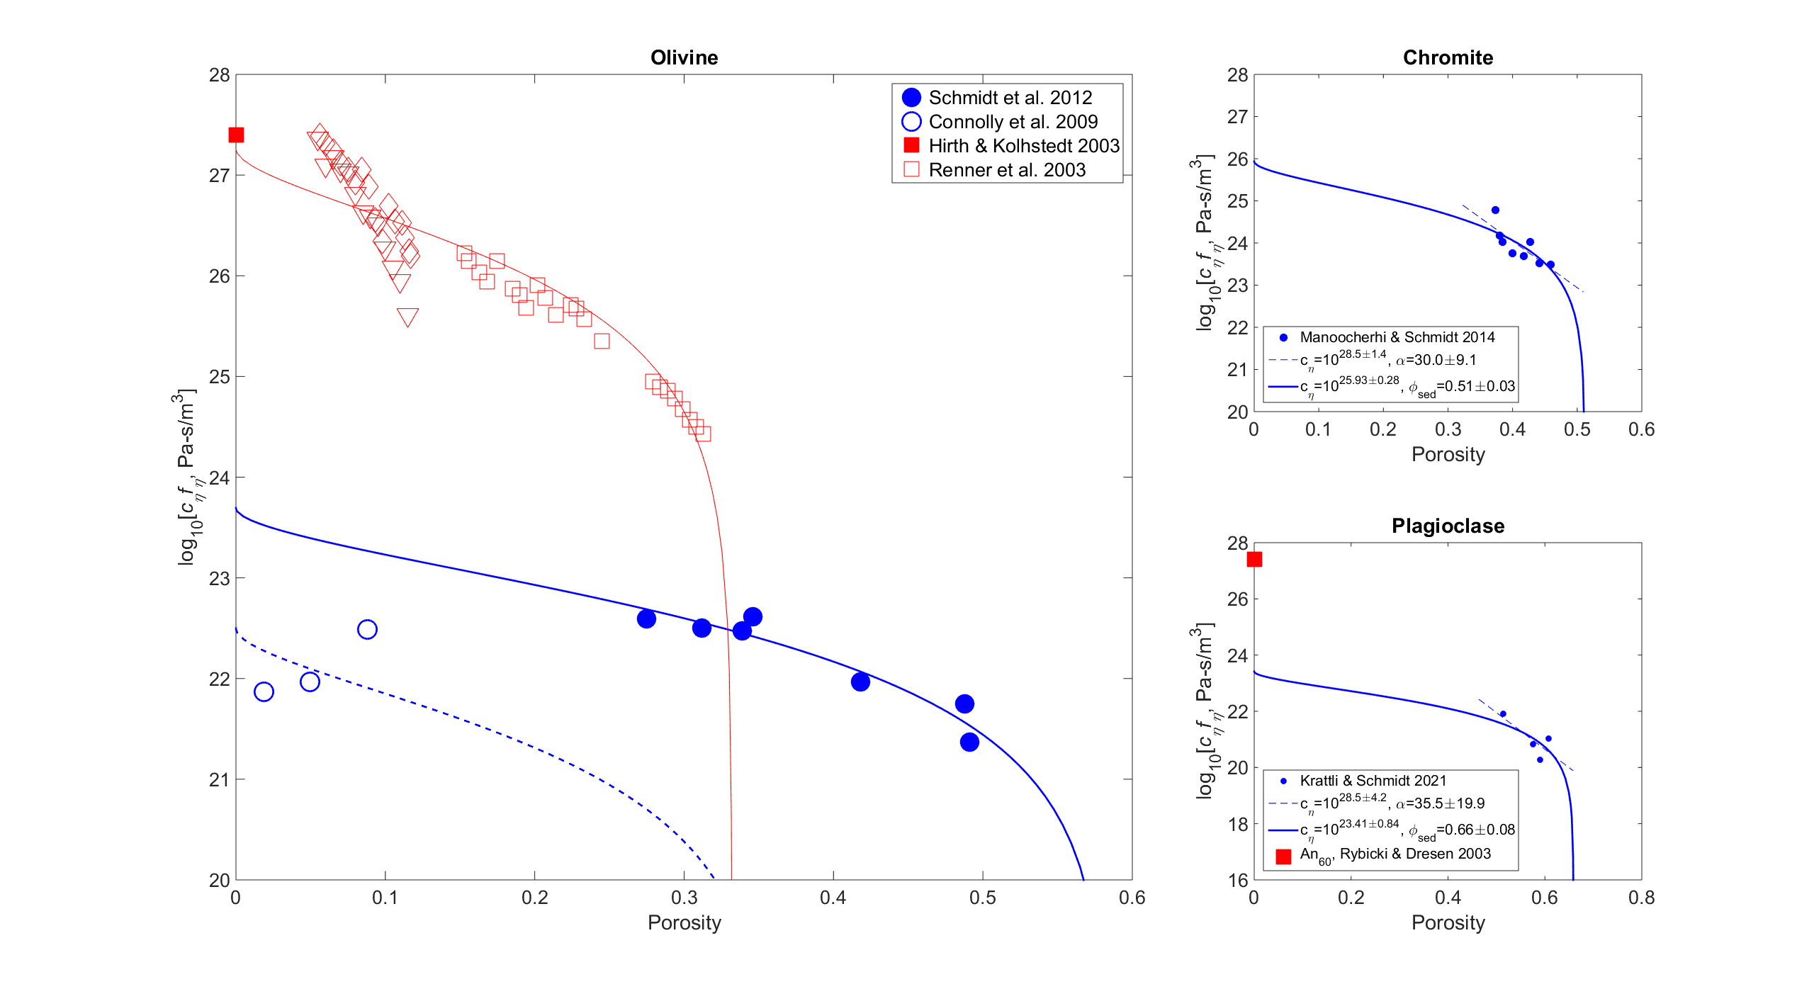
Results
Notes:
Centrifuge results in solid blue,
vertical axis is regularized viscosity,
the curves are the fit to the takei and holtzman model,
extrapolate to the matrix shear viscosity at zero porosity and the sedimentary porosity on the porosity axis
So for the ol expts eta 10^24 Pa-s, phis 58%
Dashed curve/open circles are the earlier “permeability” expts, about an order of magnitude too low
Red symbols from an amazing set of expts by Renner, direct obs of compaction rate at pe ~ 5-50 MPa. Didn’t receive much attention but essentially in perfect agreement with the consensus rheology of H&K, which represents a large body of low-porosity.
There is no way the 4 orders of magnitude discrepancy can be explained by experimental error.
It has been suggested that despite the evidence for GBD that dominance of a repacking rheology can explain the discrepancy.
Repacking would be primarily grain shape dependent, that the chromite viscosities are 3 orders of magnitude higher than olivine viscosities is inconsistent with this hypothesis.
The plag results are also shown, in both rock mechanics and in the centrifuge o & p have similar rheologies and again the same discrepancy persists.

Slide 21
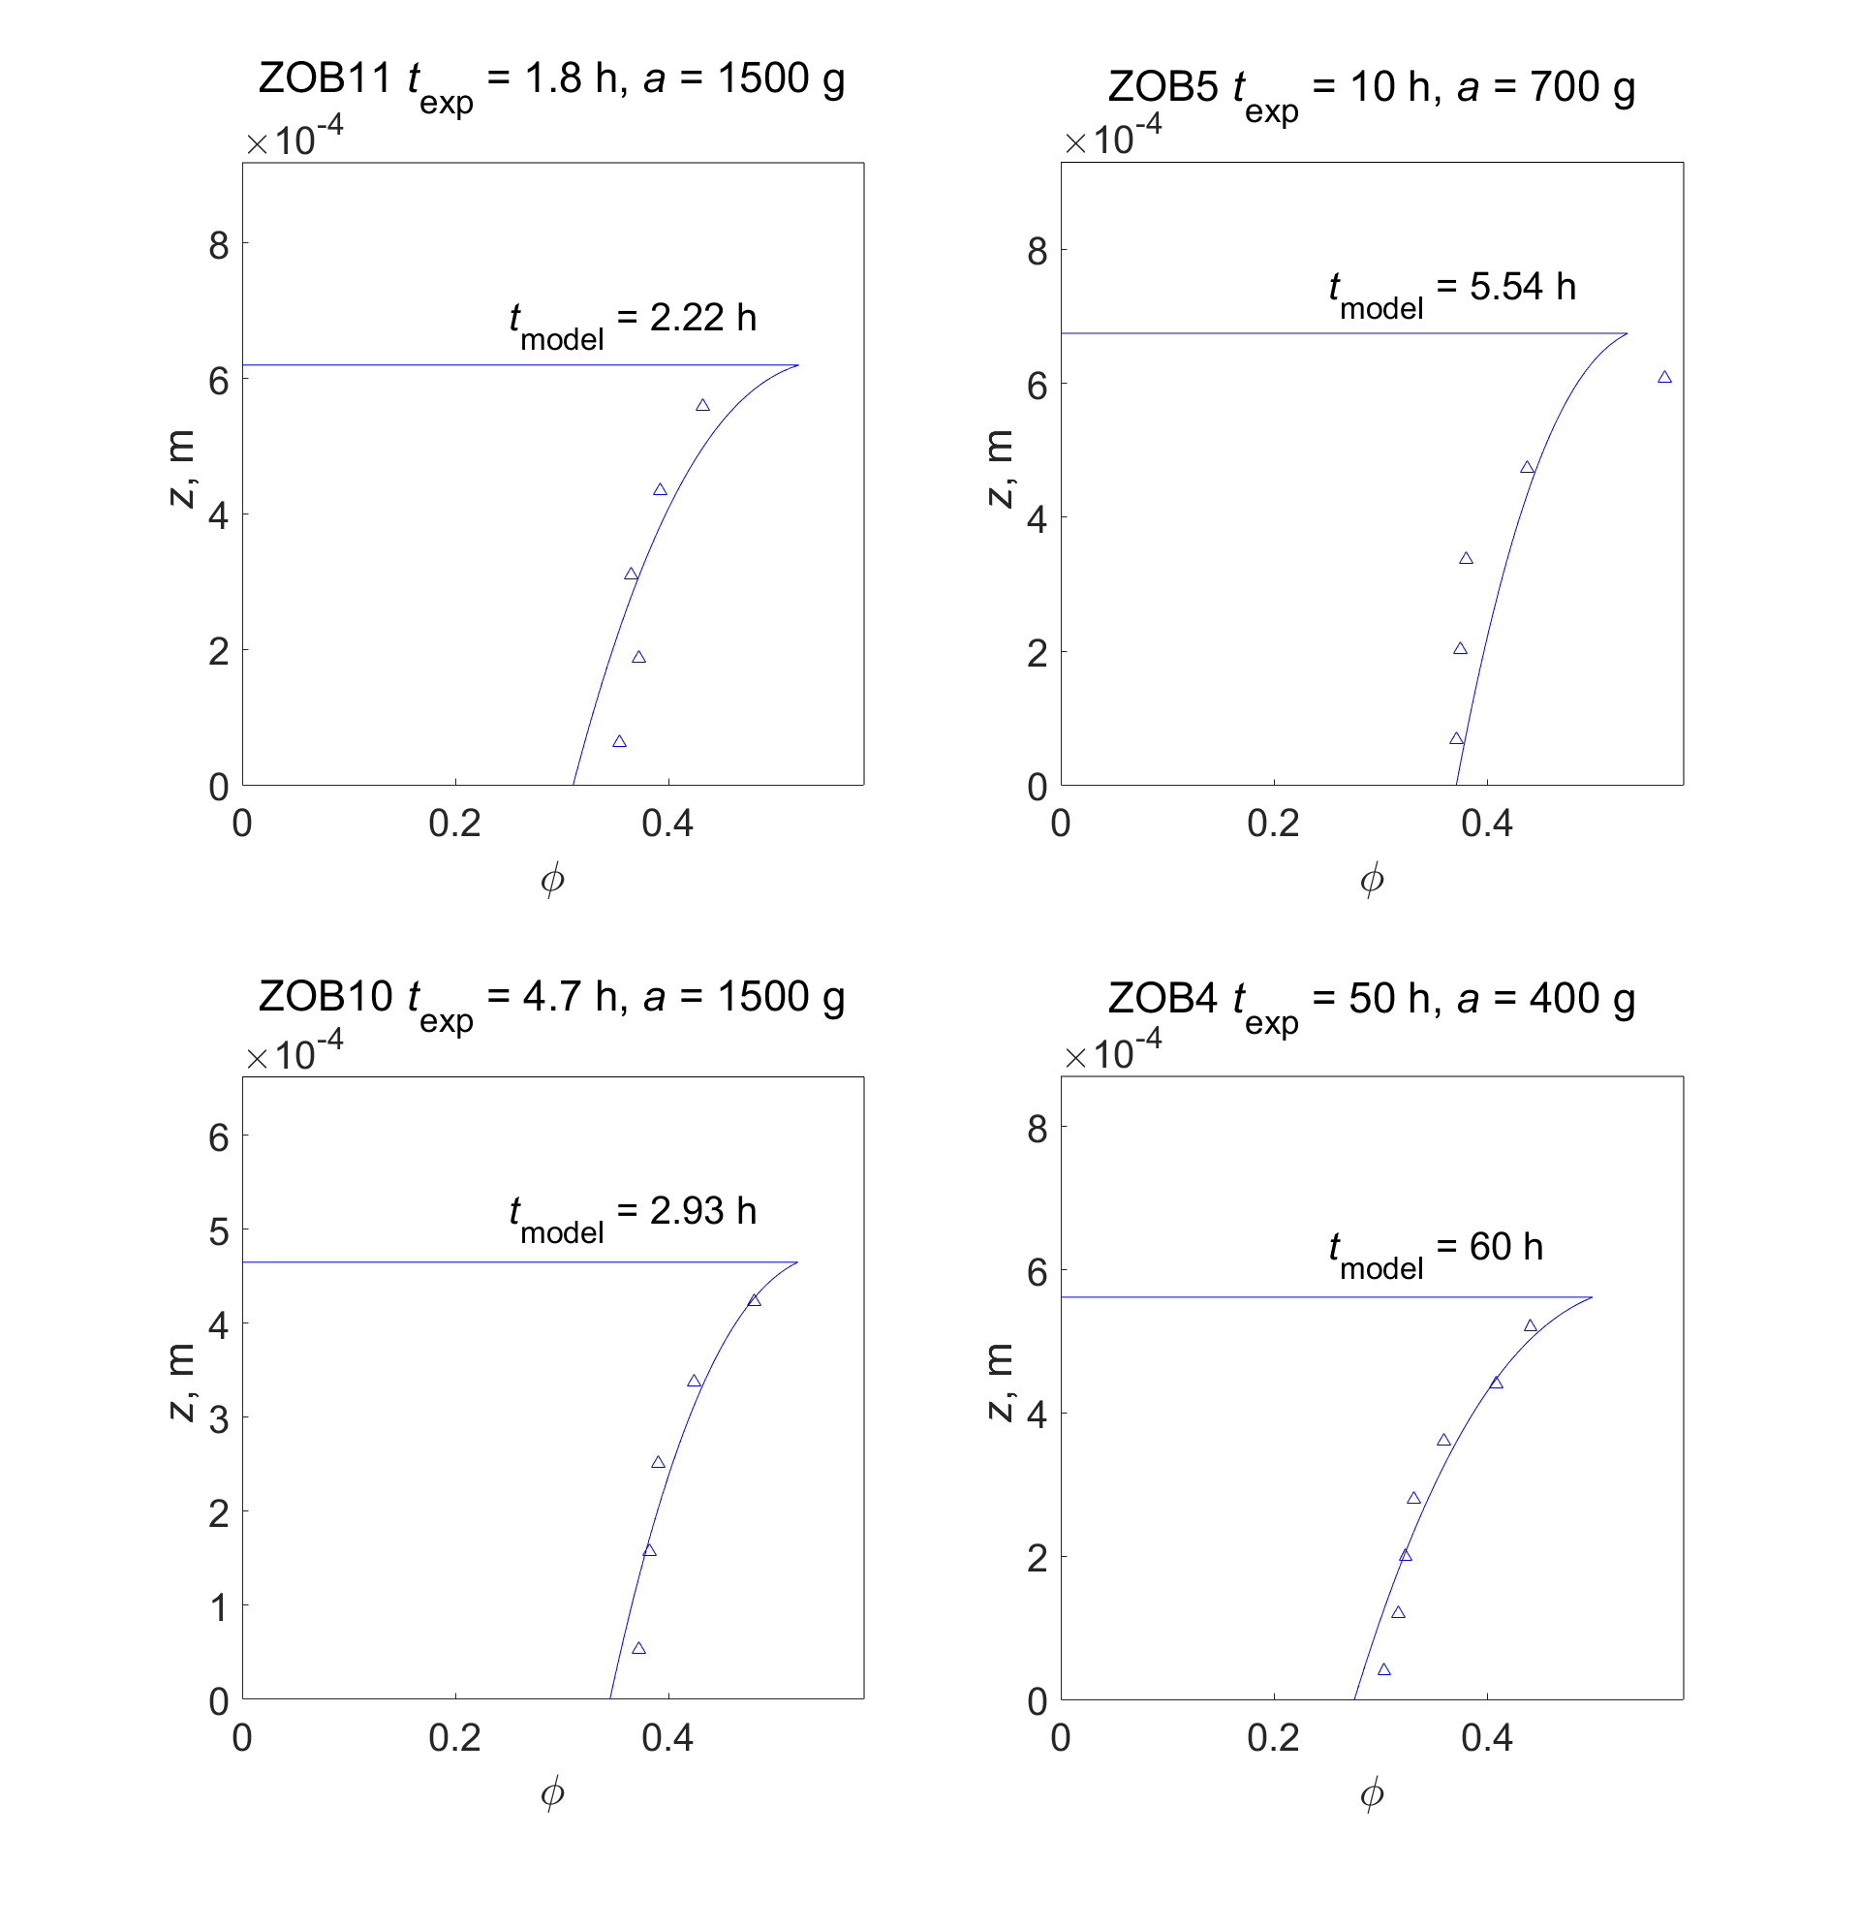
Back-calculated profiles for the
4 most compacted olivine experiments
Can it be right? Self-consistency test I:
Surface compaction induced by accounting for the pressure variation due to finite grain size
Notes:
Models calculated to match the average porosity of the experiment…
The analysis uses only the basal porosity.

Slide 22
Can it be right? Self-consistency test II:
Assumption #1: settling is instantaneous,
Assumption #2: hydraulically-limited phase is short,
Assumption #3: hydraulically-limited compaction is minor,
hydraulic regime
Assumption #4: h/δ corresponds to the assumed regime
rheologic regime

Slide 23
What does nature have to say?
Viscosities inferred for partially molten crust and mantle by geophysical inversion* are 10¹⁶-10¹⁸ Pa-s
Centrifuge**: 10¹⁶-10¹⁷ Pa-s
Rock mechanics: 10¹⁹-10²¹ Pa-s
*Morgan & Smith 92, Selway et al 20, Vergnolle et al 03, Jones & Maclennen 05, Yamasaki & Kobayashi 18, etc
**d = 2 mm, T = 1373 K

Slide 24
Is diffusion creep viable in the mantle?
Diffusion creep is dominant at length scales of < 25 km

Slide 25
Compaction half-time – the time to reduce the porosity of a molten layer/region by half:
Dimensionless numerical results
Does the viscosity matter?
dimensional time scales directly with viscosity
Does it’s porosity dependence matter? Or the Melosh-Stevenson-McKenzie essential physics effect:
1-2 orders of magnitude isn’t chicken feed or is it?

Slide 26
Layered Igneous Intrusions
Compaction lengths (δ) are 1-10 km >> layer thickness (1-30 m)
-> cumulate compaction is rheologically-limited
Olivine t_{1/2} ∼ 10³ y < t_{cooling} ∼ 10⁴ y
Silicate bulk viscosities ~ 10¹⁵-10¹⁶ Pa-s
Previously ~ 10¹⁹-10²⁰ Pa-s
Estimates from nature* (10¹²-10¹⁷ Pa-s) are 1-2 orders of magnitude too low
*Shirley 86, Boudreau & Philpots 02, Tegner et al. 09, McKenzie 11.

Slide 27
Conclusion
Everything happens faster in a centrifuge
An order of magnitude lower permeability, 4 orders of magnitude lower matrix viscosity
Something’s wrong, odds are it’s in the centrifuge experiments, but I can’t find it
The centrifuge numbers are consistent with models based on natural observations
Repacking (strain-hardening) happens and in nature and materials science it can be rate-limiting; however the notion that it is rate-limiting in the centrifuge experiments verges on the ludicrous

Slide 28
Conclusion
The centrifuge compaction profiles identify compaction regime (rheologically-limited)
The resulting viscosities are wildly discrepant with previous experimental results (>3 orders of magnitude) but consistent with estimates inferred from nature

Slide 29
Hydraulically-limited compaction (h/δ > 1)
Convex!

Slide 30
Rheologically-limited compaction, h/δ < 1
Convex
Convex-ish
Concave

Slide 31
Compaction half-time – the time to reduce the average porosity by half: does the porosity dependence matter?

Slide 32
Is diffusion creep viable in nature?
Diffusion creep is dominant at length scales of < 25 km

Slide 33
George Bergantz

Slide 35
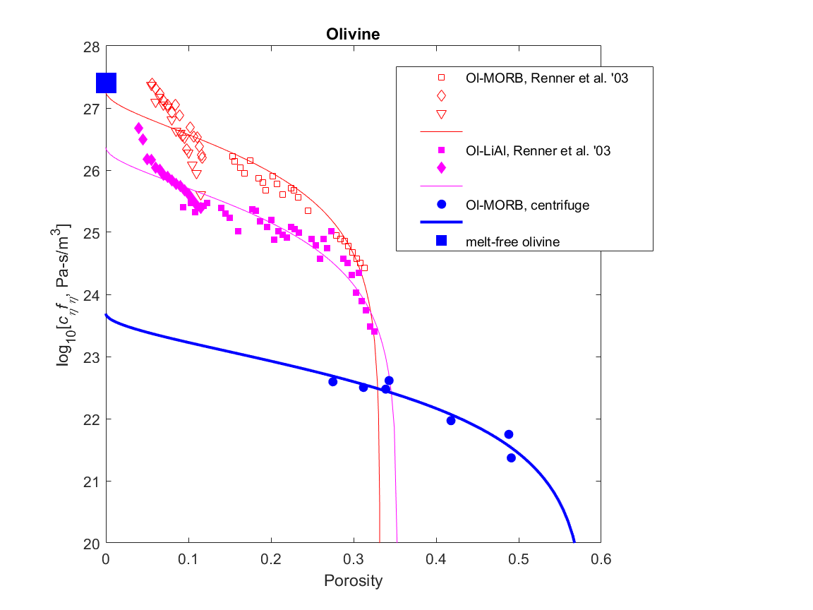
What is really fit: log(viscosity) = log[c_{η}f_{η}(φ)]
φ → 0, f_{η}(φ) → 1, c_{η}f_{η} → c_{η}
φ → φ_{sediment,} c_{η}f_{η} → 0

Slide 36
Mechanism: macroscopic rheology
Elasticity: instantaneous reversible deformation -> strains are too small to be effective
Plasticity: instantaneous irreversible deformation ->
grain crushing and rotation (repacking), strain-hardening
low temperature and/or high porosity (sedimentary basins, layered intrusions)
during uni-directional loading (sedimentation) pseudo-viscous or pseudo-elastic
Viscosity: time-dependent reversible deformation ->
high temperature and/or low porosity (metamorphism, partial melting)
how?

Slide 37
What’s supposed to happen (without compaction):
t₀
t₁
φ_{sed} is a proxy for grain coordination number, it is identical to the matrix disaggregation porosity (φ_{d})
φ_{sus}
Grain contact area (Takei & Holtzman 2013)
φ_{sed}
φ ® φ_{sed} Þ ξ ® 0, the initial stage of compaction must be hydraulically-limited

Slide 38
What causes the effective pressure (p_{e})? Static pressure gradient ∝ density (ρ)
φ₀
pressure
p
porosity
φ
rheologically-limited
h₀ << δ₀
fluid flux negligible
observation constrains ξ
h₁, t₁
h₂, t₂
t₀
h₀
z
p_{fluid}
p_{solid}
z
z
φ₀
pressure
p
porosity
φ
hydraullically-limited
h₀ >> δ₀
p_{e} negligible
observation constrains k
h₁, t₁
h₂, t₂
p_{e} » 0
p_{total} = p_{fluid} = p_{solid}
z
z

Slide 39
Mechanism: Macroscopic rheology
Elastic solids: independent shear (G) and bulk modulus (K)
Viscous solids: shear viscosity (η), no bulk viscosity (ξ)
Porous solids:
macroscopic bulk viscosity (ξ) due to compaction of grain-scale porosity (φ)
accomplished by microscopic shear -> ξ = f(η_{solid}, η_{fluid}, φ)
Newtonian?
Because η_{solid} (> 10⁸ Pa s) >> η_{fluid} (< 10² Pa s), assume ξ = ξ_{solid} = f(η_{solid}, φ)

Slide 40
Viscosity of partially molten crystal mushes
J.A.D. Connolly & M.W. Schmidt, ETH
Why should you care?
expulsion is by irreversible compaction
its time-scale is determined by rock viscosity

Slide 41
Outline
The viscous compaction mechanism
Some unusual compaction experiments and analysis thereof
Implications

Slide 42
Mechanism: Macroscopic rheology
Elastic solids: independent shear (G) and bulk modulus (K)
Viscous solids: shear viscosity (η), no bulk viscosity (ξ)
Porous solids:
macroscopic bulk viscosity (ξ) due to compaction of grain-scale porosity (φ)
accomplished by microscopic shear -> ξ = f(η,φ)
Newtonian?

Slide 43
Plagioclase & Chromite

Slide 44
The microscopic comedy of macroscopic Newtonian rheology
Newtonian creep - geodynamics
Diffusion creep – rock mechanics
Driving force is effective pressure, p_{e}
solid deforms as a fluid
dislocation creep ->
non-linear stress dependence
solid is rigid
deformation by diffusive mass transfer
grain-boundary diffusion creep
ζ = f(η_{solid},φ) => φ → 0, ζ → ∞
ζ = f(η_{solid},φ) => φ → 0, ζ → η_{solid}
ξ = bulk viscosity
η = shear viscosity

