Slide 1
What is Perple_X?

Slide 2
An engine the predicts the equilibrium properties of a system by free energy minimization.
Most commonly used to construct phase diagram sections for closed chemical systems.
Connolly, 2010
PHREEQC and PFLOTRAN have such an
Typically, this engine is used to construct phase diagram sections

Slide 3
It can be used to recover any thermodynamic property (e.g., phase compositions/amounts, heat capacity, density, elastic moduli):
Metabasalt P-wavespeed
Connolly & Kerrick 2002
Geophysical inversions and geodynamic models
PHREEQC and PFLOTRAN have such an

Slide 4
Phase diagram models generally assume closed system behavior, fluid migration (aka, reactive transport) is anything but.
Truly dynamic models can call on Perple_X’s engine
Built in path-dependent calculations:
Kinematic
Local Equilibrium
Neither diffusion nor chemical kinetics

Slide 5
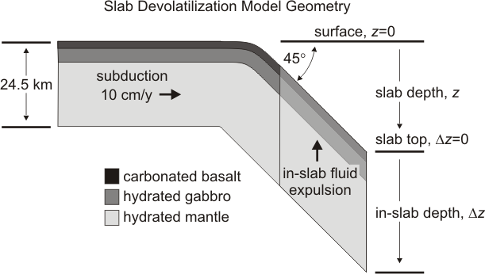
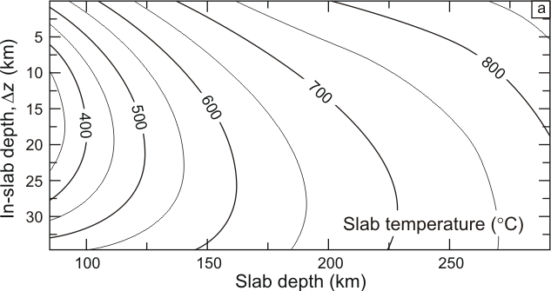
An example: infiltration–driven decarbonation of subducted oceanic crust
Connolly 2005

Slide 6
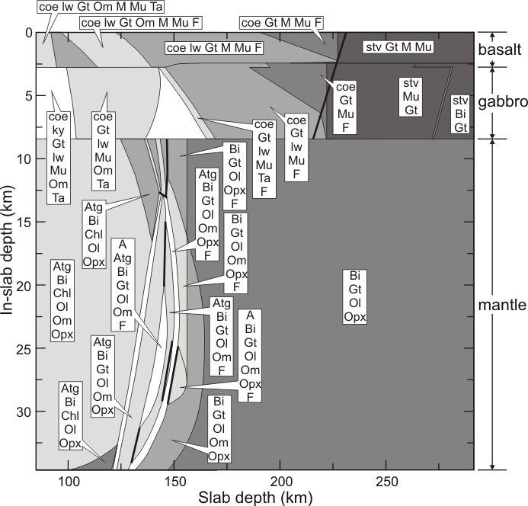
Slab phase relations:
Connolly 2005

Slide 7
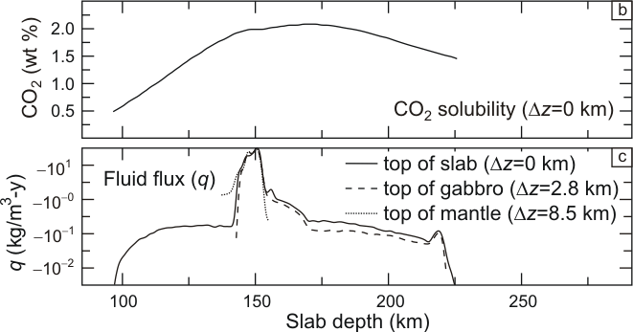
Slab fluid composition and production
Connolly 2005

Slide 8
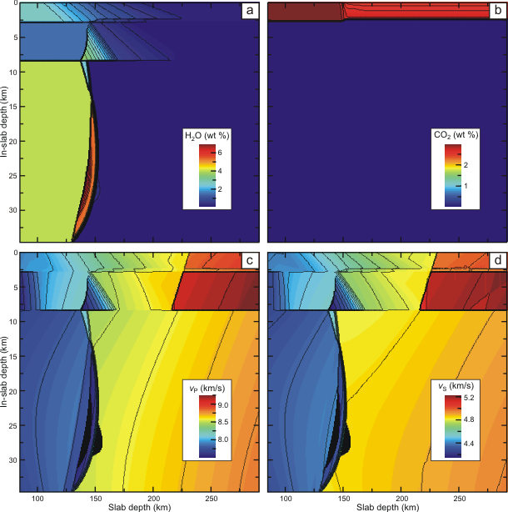
Slab Properties
The punchline: infiltration-driven decarbonation important is even less effective than the closed-system model.
Connolly 2005

Slide 9
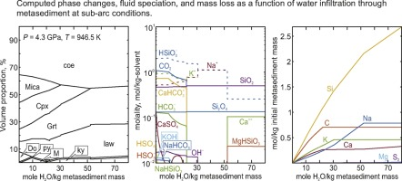
O-d Titration
Connolly & Galvez 2018

Slide 10
Perple_X can treat electrolytic fluids, but it is far from PHREEQC, PFLOTRAN, GEMS etc.
Lagged speciation (Connolly & Galvez, 2018) a method for rock-dominated fluids
Solvent components – the components (usually C-O-H-S) necessary to describe the “pure” molecular solvent.
Solute components – the components (e.g., K, Na, Si) necessary to describe the solute load.
No solute component may be present solely in the fluid phase (e.g., if K is completely dissolved, lagged speciation cannot be used.
Put another way: the chemical potentials of the system must be determined entirely from the equilibrium of the solvent and the condensed phases of the system.

Slide 11
What is free energy minimization?

